Slide 1

Systems Performance Specifications
15 November 2018
Systems Performance Specifications
15 November 2018
presented by
Notes:
ada

Slide 2

WHAT IS ECHO?
ABOUT US
Year-long engineering senior capstone class and team
34 students per team that research, design, construct, and test a solution to an open-ended engineering problem
Entirely student-led
This program is designed to…
combine research, academic study, collaboration and discovery-based learning in an interdisciplinary environment
inspire each student to develop the confidence and ability to embrace the challenges of the future and to work toward the betterment of the human condition
Notes:
ada

Slide 3
“
Design of a product, development of a person.
”
Notes:
ada

Slide 4
Executive Summary
VISION STATEMENT
To create ideas worth hearing that inspire the communities we serve, through the products we develop, and the leaders we cultivate.
Notes:
ada

Slide 5
Executive Summary
MISSION STATEMENT
ECHO Technologies seeks to surpass industry standards and achieve excellence as an engineering business by promoting student-led discovery in the development of technical solutions, education of communities, and the growth of individual persons.
Notes:
ada

Slide 6
ECHO TECHNOLOGIES
TEAM BREAKDOWN
53%
47%
Project Manager
Deputy Project Managers
Chief Scientist
Chief Financial Officer
Director of Mechanical Engineering
Director of Electrical Engineering
Director of Systems Engineering
Director of Manufacturing
Director of Programming
Director of Outreach
Director of Media
Director of Interns
Members of the Technical Staff
Notes:
ada

Slide 7
MISSION OVERVIEW
Notes:
DPMS introduce themselves, cat + celia

Slide 8
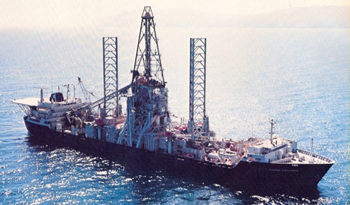
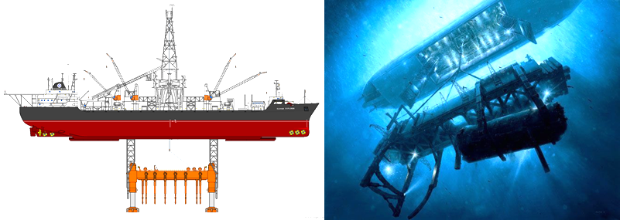
Executive Summary
EXECUTIVE SUMMARY
(PROBLEM STATEMENT)
The CIA failed to completely recover a valuable Soviet submarine with nuclear capabilities from the ocean floor. As a ship was raising the K-129 from the ocean floor, it broke apart and part of the submarine was lost, including its cargo.
ECHO Technologies is tasked to design, model and test a UAV/UUV vehicle (Megalodon) that can recover the items of interest from the K-129 after pinpointing a signal from an ROV vehicle (Remora) that locates those items of interest.

Slide 9
MISSION THEATRE
Search of Wreckage
Recovery of items of interest
Return of Megalodon and Remora
Notes:
brad

Slide 10
MEGALODON DELIVERABLES
Must...
be completely waterproof.
be capable of flight, in dual fluid mediums.
fly 201.9 feet in the air to the pool, locate the pool, and dive into the pool, swimming to the wreckage.
manipulate recovery articulation.
be able to detect the beacon of the Remora, and retrieve it, once the salvage operation is complete.
NOT be tethered
Notes:
•Be completely waterproof.
•Be capable of flight, in dual fluid mediums.
•Fly 201.9 feet in the air to the pool, locate the pool, and dive into the pool, swimming to the wreckage.
•Manipulate recovery articulation.
•Be able to detect the beacon of the Remora, and retrieve it, once the salvage operation is complete.

Slide 11
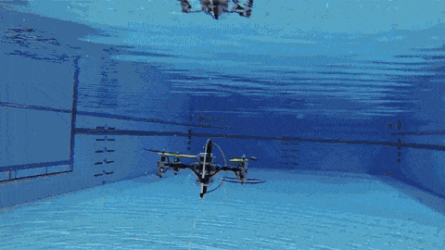
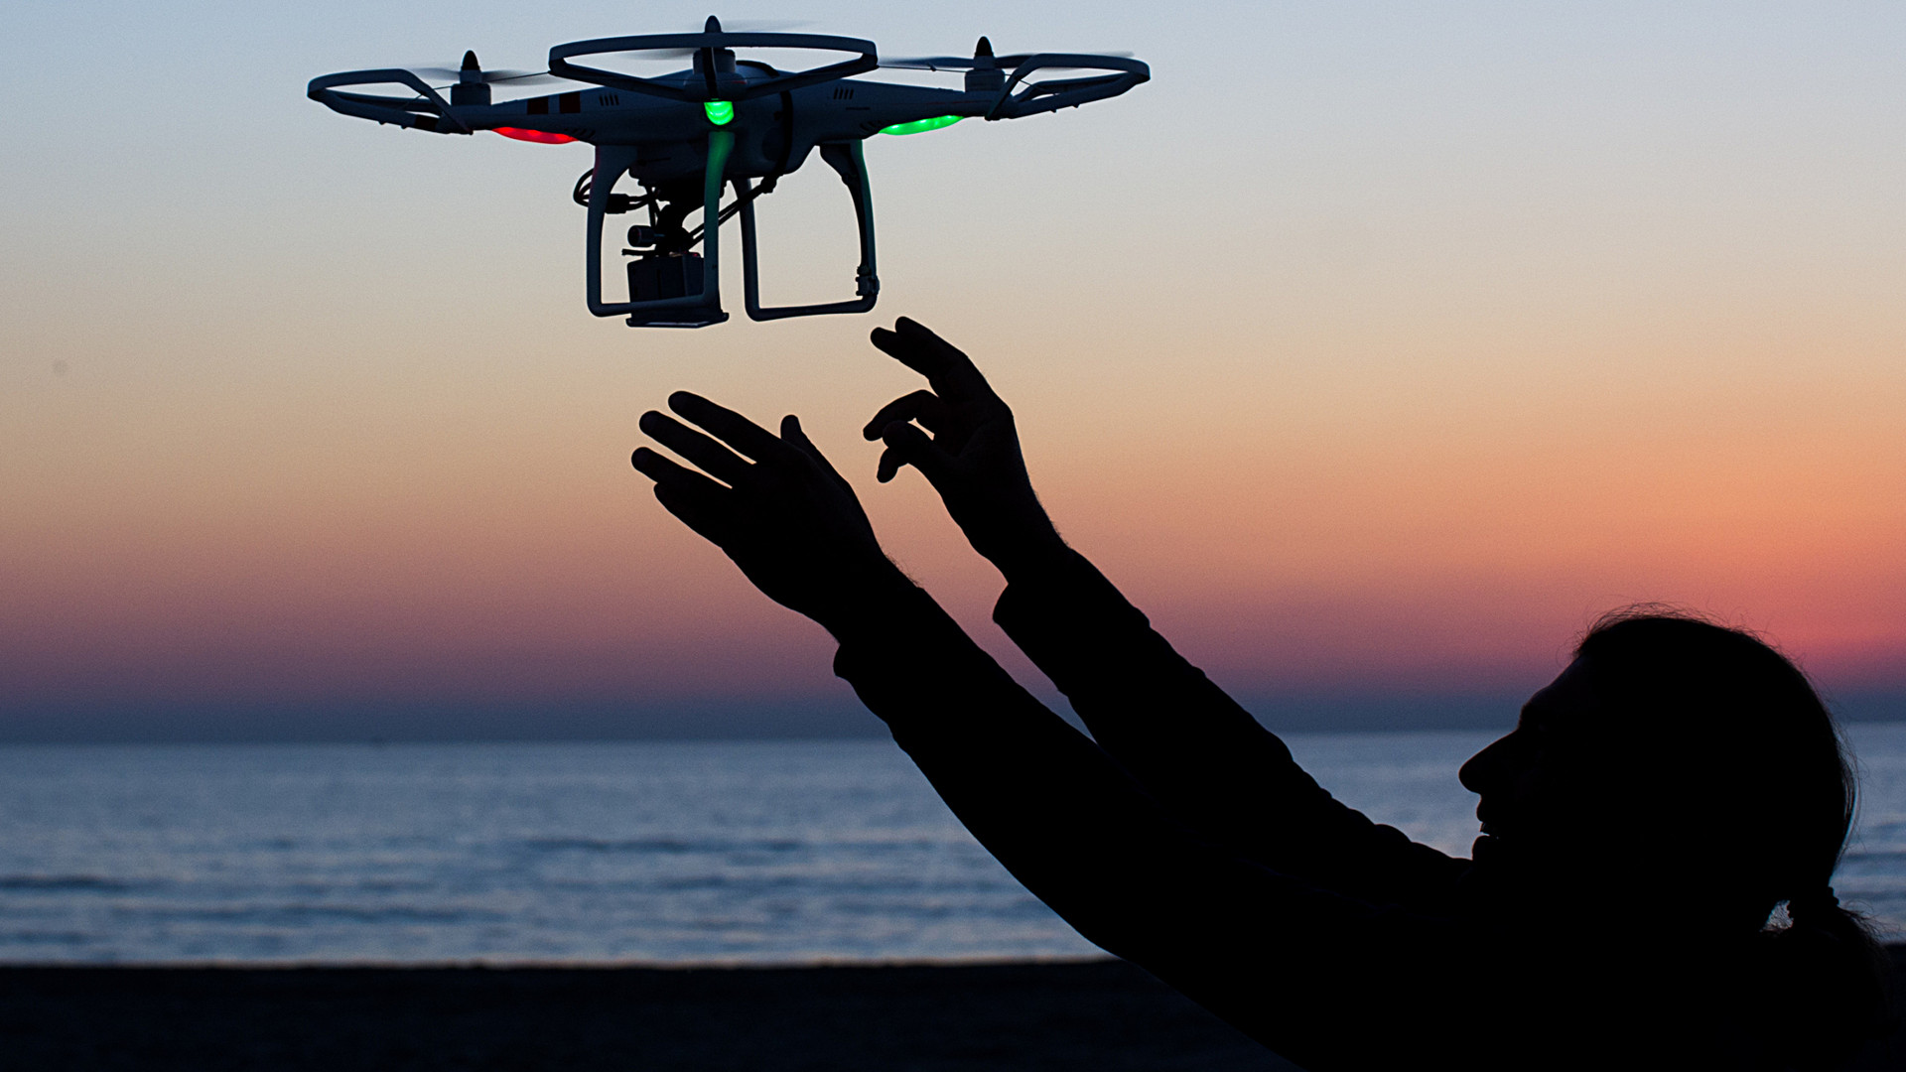
AERIAL SUBSYSTEM
CRITERIA & CONSTRAINTS
Specific System Problems:
Autonomous flight (with Vision)
Automatic Vision Targeting
Flying a linear distance of 201.9 feet
Watertight enclosures for diving
Flight testing and FAA Legalities
Physical obstructions when flying to body of water

Slide 12
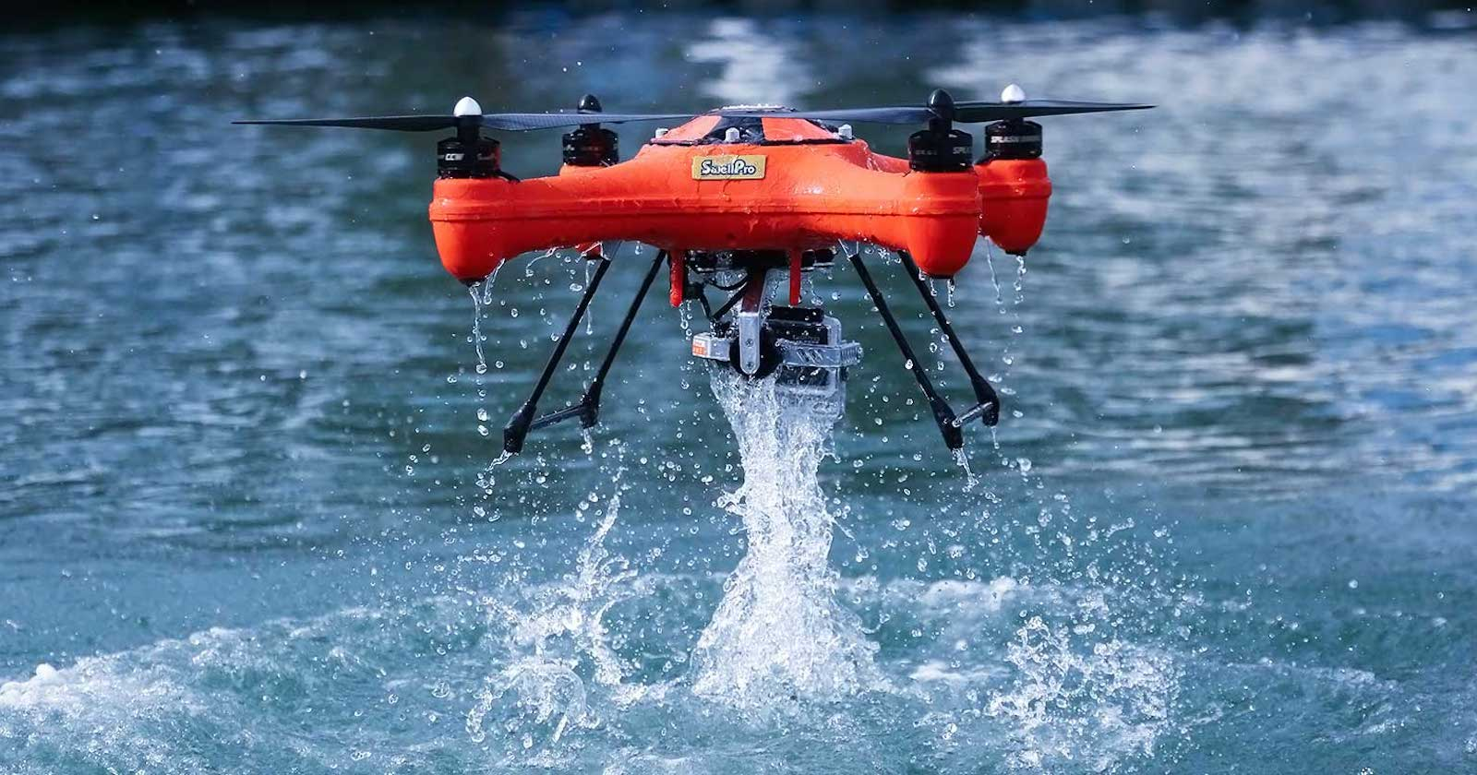
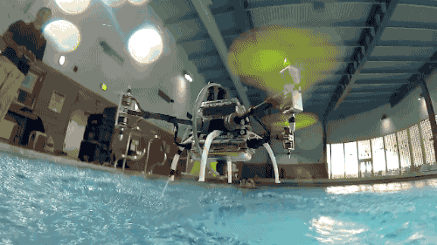
AQUATIC SUBSYSTEM
CRITERIA & CONSTRAINTS
Specific System Problems:
Autonomous underwater flight
Automatic Vision Targeting
Watertight enclosures for underwater movement
Ability to autonomously maneuver in and out of water
Waterproof testing
Underwater communication

Slide 13
EDD INTERNSHIP PROGRAM
EDD Internship Program
Origins
Who are the interns?
What do interns do?
This year’s interns
What is their task?
Notes:
interns will explain, what it’s going to do, what type of machine is it, not anything about the design

Slide 14
REMORA DELIVERABLES
Must….
be completely waterproof
be lightweight (carried by Megalodon twice)
locate wreckage site
provide beacon
identify and retrieve any nuclear items through radioactive detection sensors
Notes:
interns will explain, what it’s going to do, what type of machine is it, not anything about the design

Slide 15
OUR APPROACH
Notes:
Taste of CAMS

Slide 16
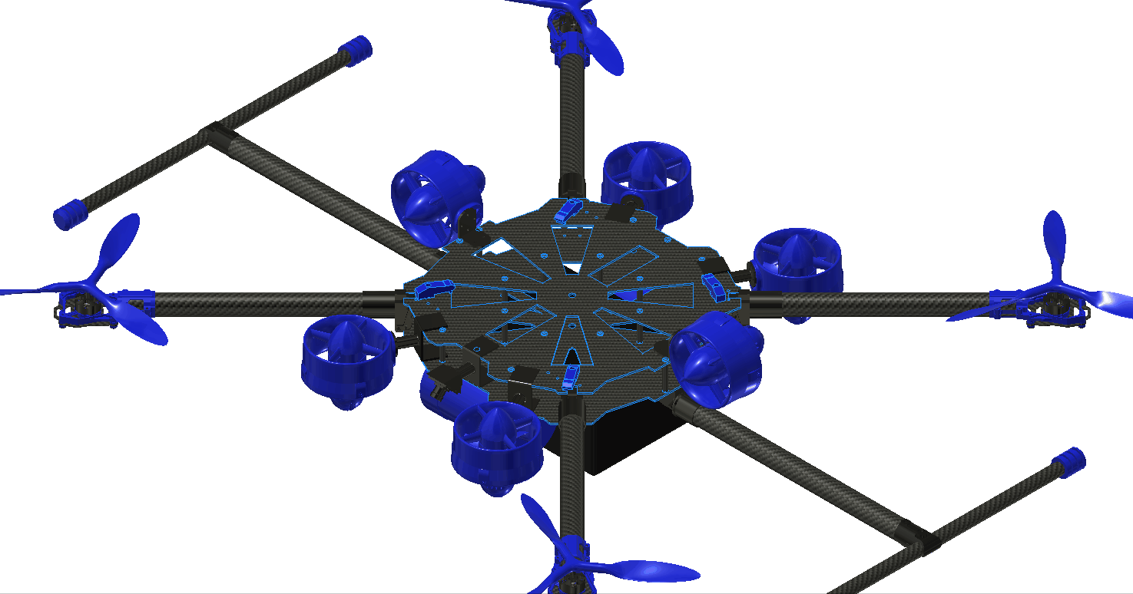
DESIGN OVERVIEW
MEGALODON
Carbon Fiber Frame
4 aerial motors
6 underwater motors
Object Recovery Mechanism
Notes:
Mention hold questions to after. this is brief, and we will hopefully justify our decisions later
do the overview!
Michael

Slide 17
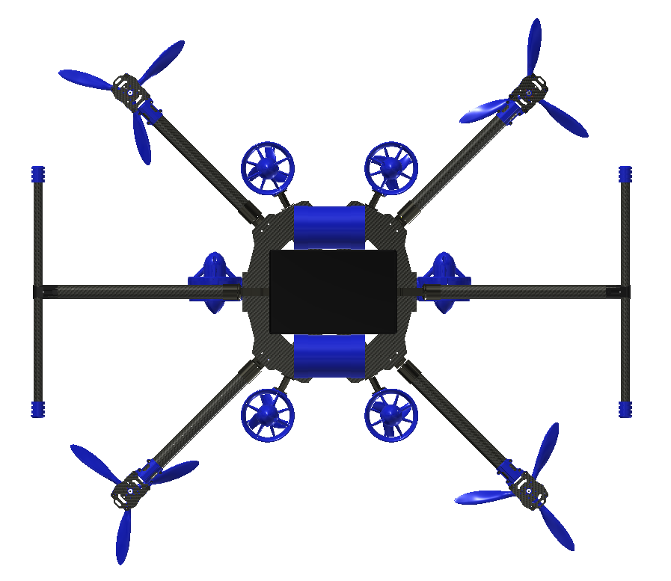
DESIGN OVERVIEW
MEGALODON CONT.
Watertight Electronics Enclosure
Ballast System
Programmable flight controller and vision
Current Design Limitations
Notes:
Overview continued, the key to this design is weight and buoyancy management, trying to make life easier on the programmers (the recovery mechanism)
Mention the limitations and that we have several alternatives (decision matrix), we are only beginning to build a prototype so we have collected limited data form tests that will affect our design
Michael

Slide 18
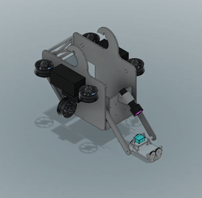
DESIGN OVERVIEW
REMORA
ABS plastic
6 underwater motors
Vision
Radioactive detection
Ballast System
Watertight Electronics Enclosure
Object Recovery System
Software

Slide 19
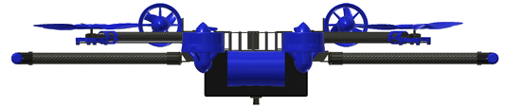
MISSION STRATEGY
Search of Wreckage
Remora Tracking System
Recovery of items of interest.
Trip Efficiency
Remora Camera
Return of Megalodon and Remora

Slide 20
MECHANICAL DESIGN
Notes:
Taste of CAMS

Slide 21
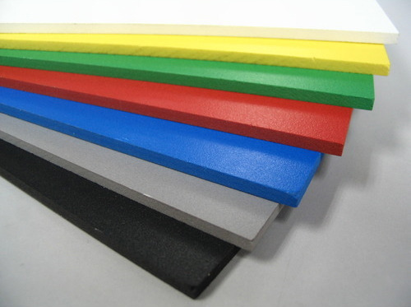
UNDERWATER CONSTRAINTS
To ensure maximum maneuverability of the Megalodon in the air and water, our material used must have the following criteria:
Impact Resistant
Water Resistant
Lightweight
Durable
Notes:
Image is of HDPE (plastic) sheets.
Image source: https://www.indiamart.com/proddetail/hdpe-sheet-13454149262.html

Slide 22
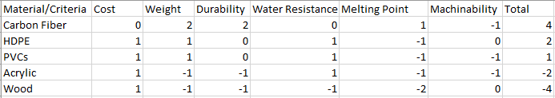
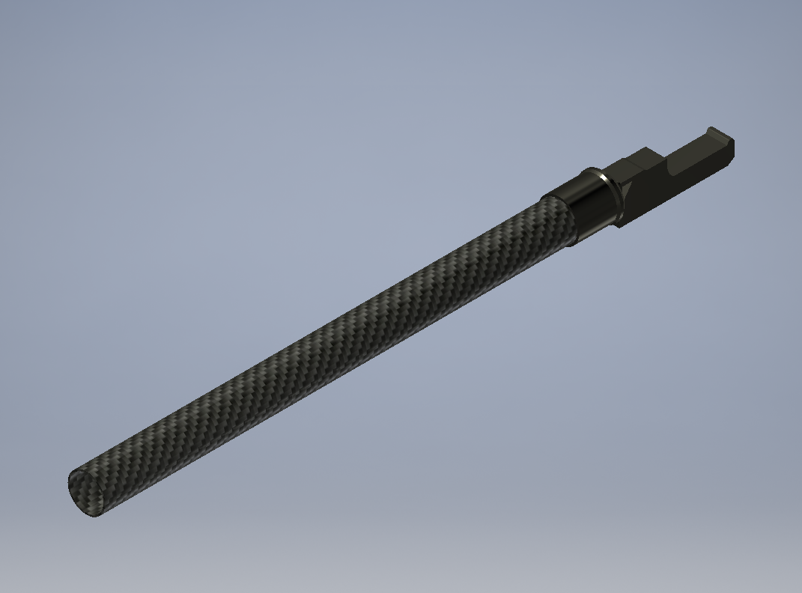
FRAME STRUCTURE DESIGN
To determine what material to build our drone out of, we brainstormed different materials and compared them in a decision matrix.
Ultimately, we chose carbon fiber because of its strength, weight, and high melting point.
Notes:
Put in CAD assembly screenshot here
Weight, durability, and melting point are the most important categories

Slide 23
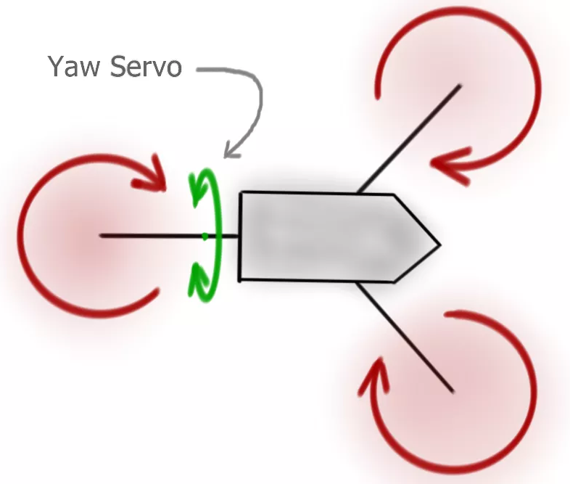
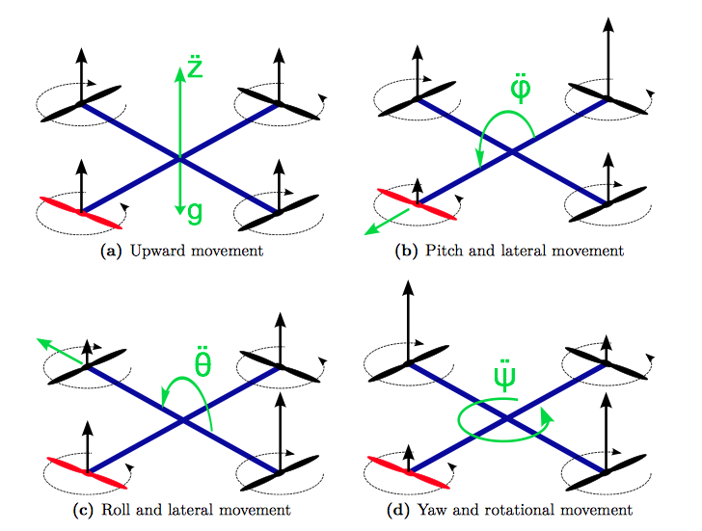
FLIGHT
Number of Motors?
Three Motors
Cheaper
Lighter
Limited mobility options
Difficult maneuvering
Four Motors
More costly
Heavier
Simpler manufacturing
Wide mobility options
Easy to maneuver
Number of Blades per Propeller?
Three Blades
More Efficient
Less thrust
Four Blades
Less efficient
More thrust

Slide 24
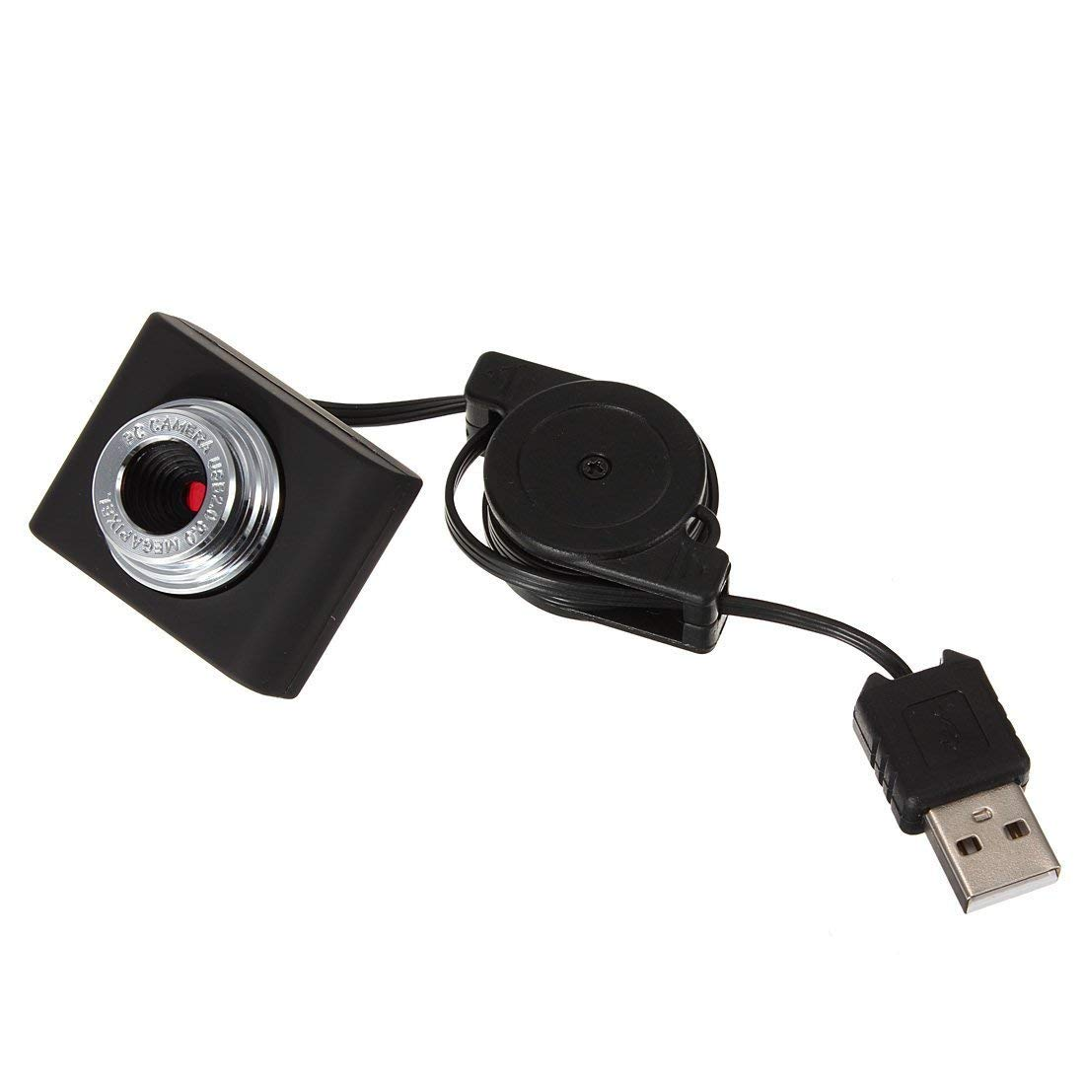
CAMERAS
Megalodon will include two cameras for broader range of view
Camera 1
Placed at the bottom of the vehicle in the center
Gives straight down view to align with Remora
Camera 2
Placed at front of drone for automatic target object retrieval
Angled 45 degrees downward

Slide 25
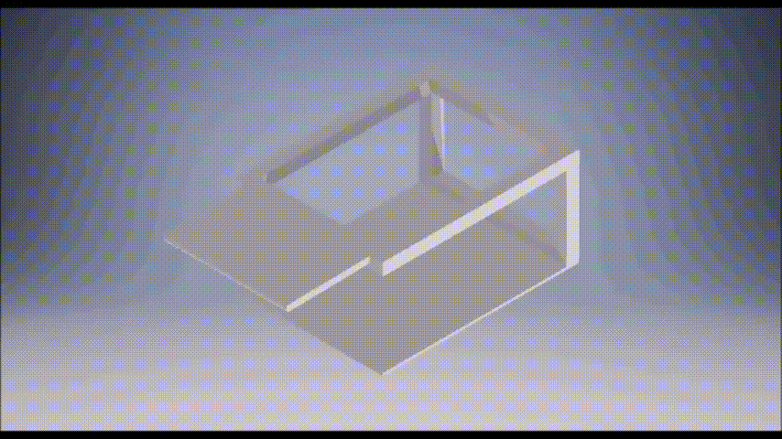
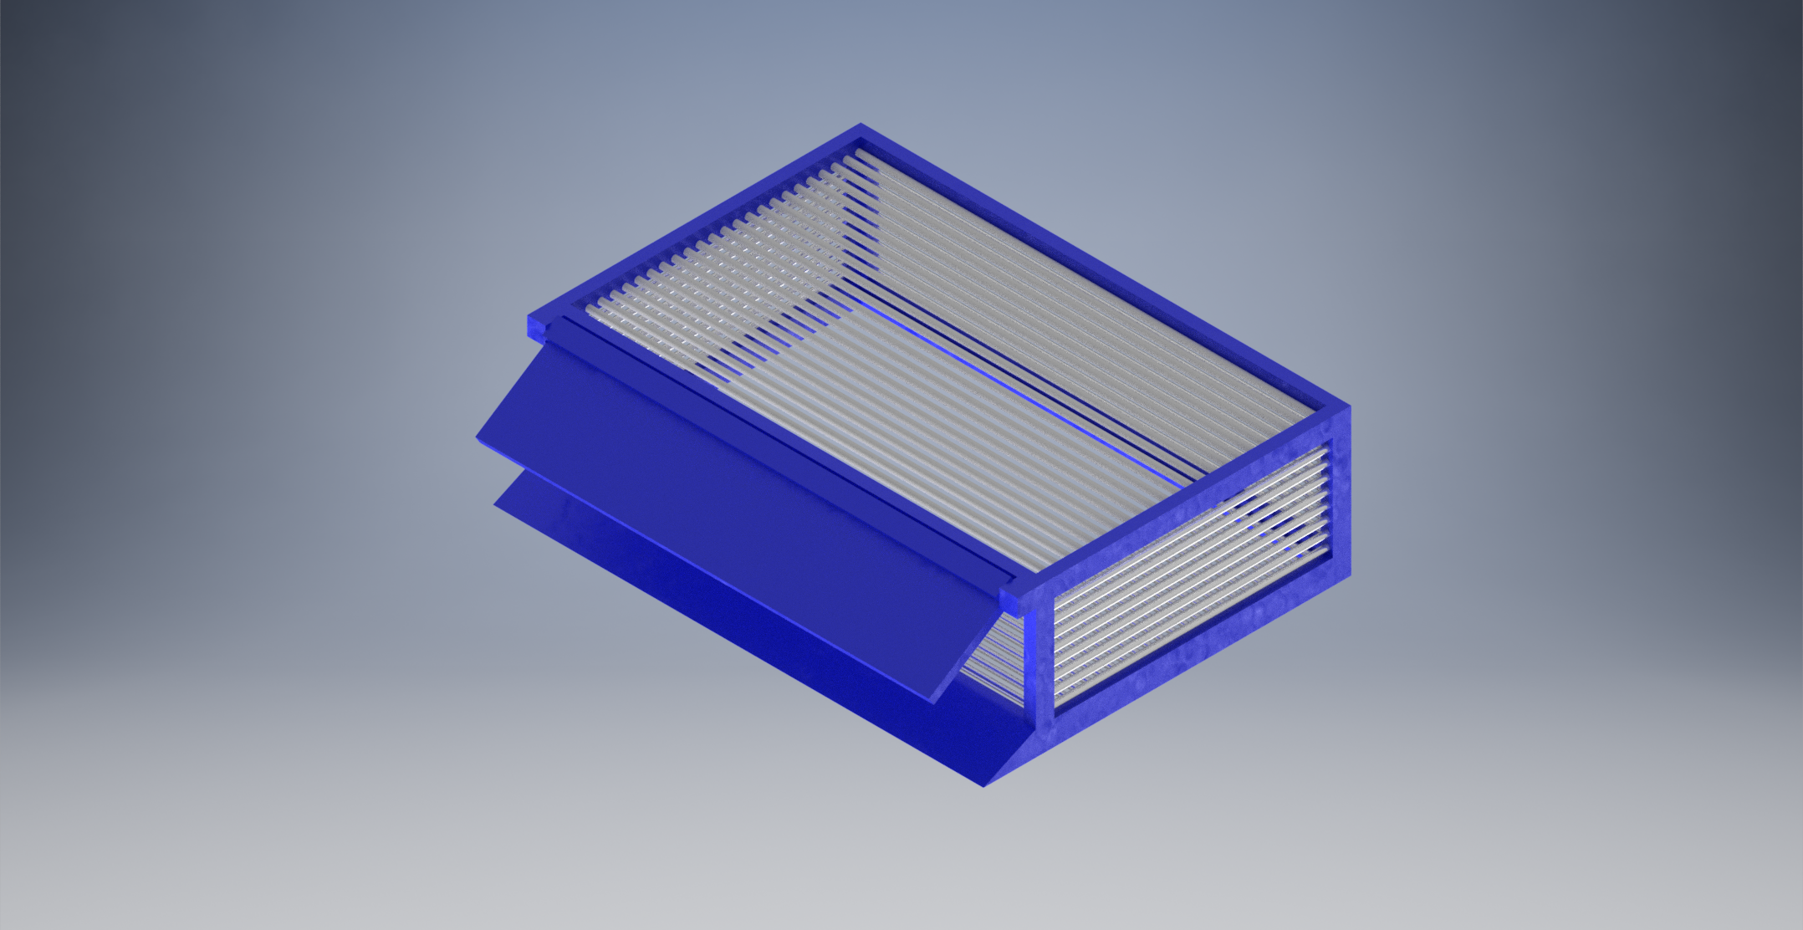
RECOVERY MECHANISM
Our recovery mechanism is similar to a broom and dustpan.
Having this system as opposed to a claw allows us to pick up multiple objects, both large and small.
Notes:
We brainstormed several ideas for different recovery systems, and this is the final design we chose to use.
We initially thought of several different kinds of claws, but decided that the biggest drawback with using a claw is that it can only pick up one object at a time. We could use multiple claws, but that would further complicate our design.
For our mission we know that we need to recover both large and small objects, so we decided to use a “broom and dustpan” system that would allow us to recover several objects at once.
The system itself is going to be mounted on the bottom of the Megalodon, underneath the electronics box.

Slide 26
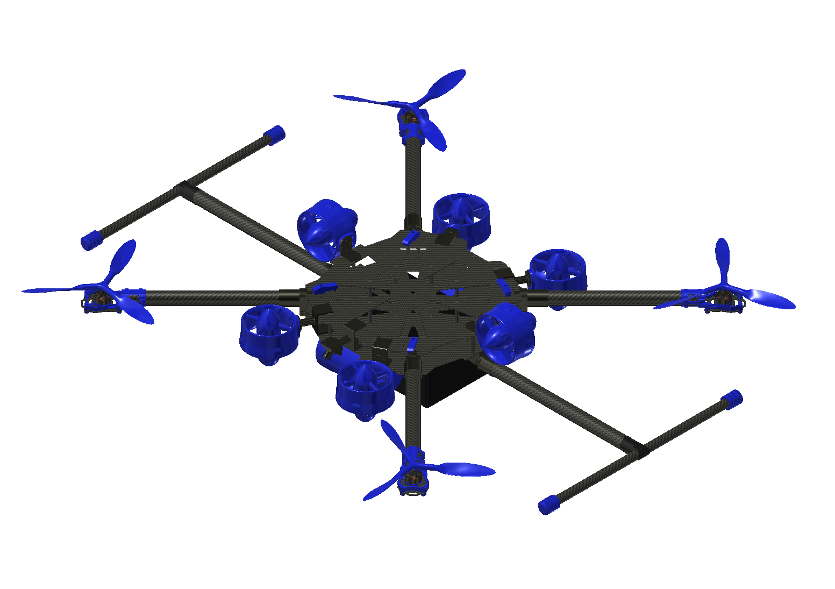
UNDERWATER FLIGHT
Our proposed system is composed of 4 aerial motors and 6 underwater thrusters.
Although we’re planning on using 6 thrusters, if our testing shows that it is more efficient to use 4, then we will adapt and use 4.

Slide 27
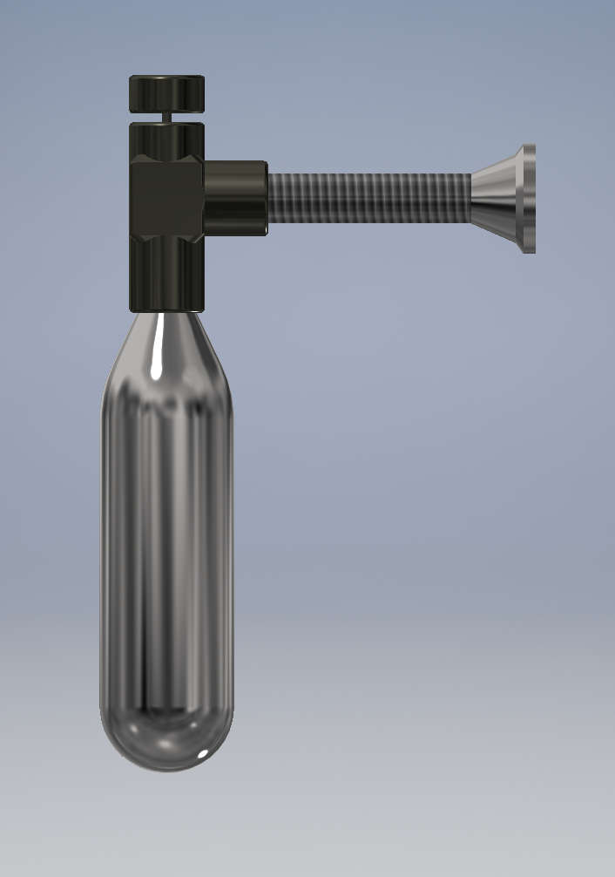
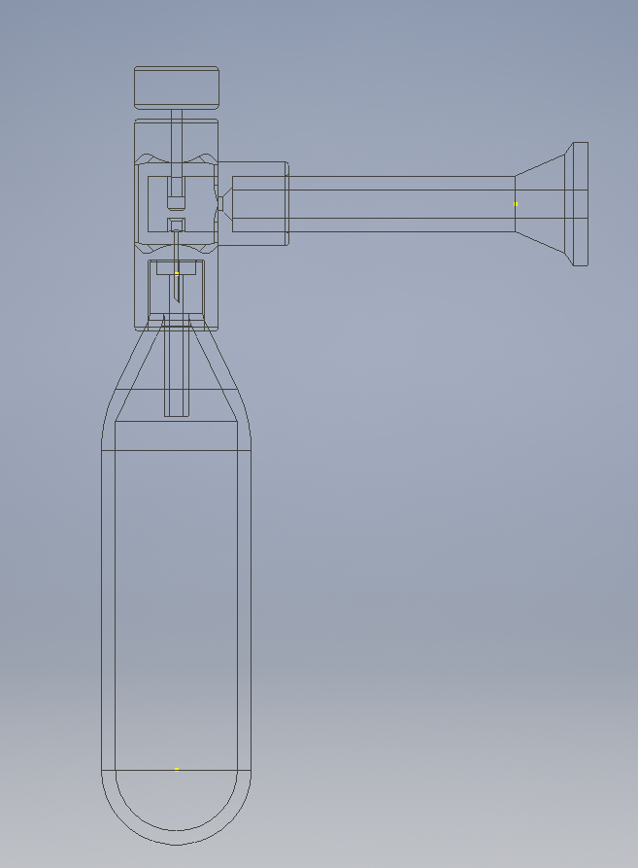
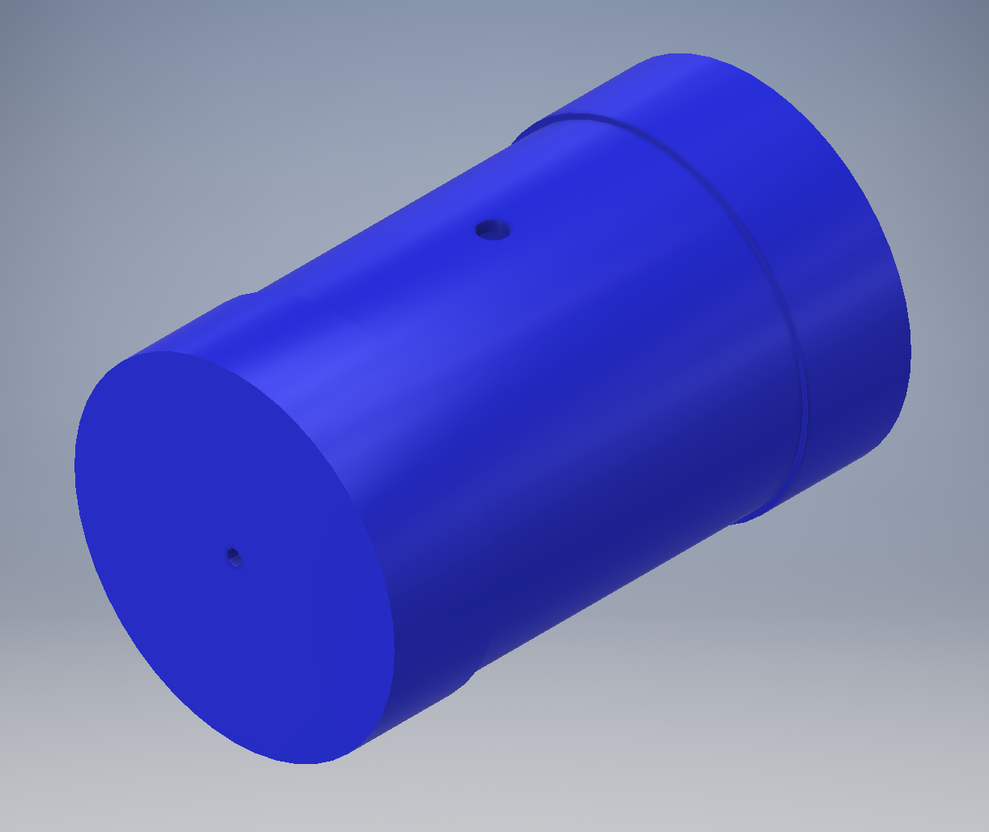
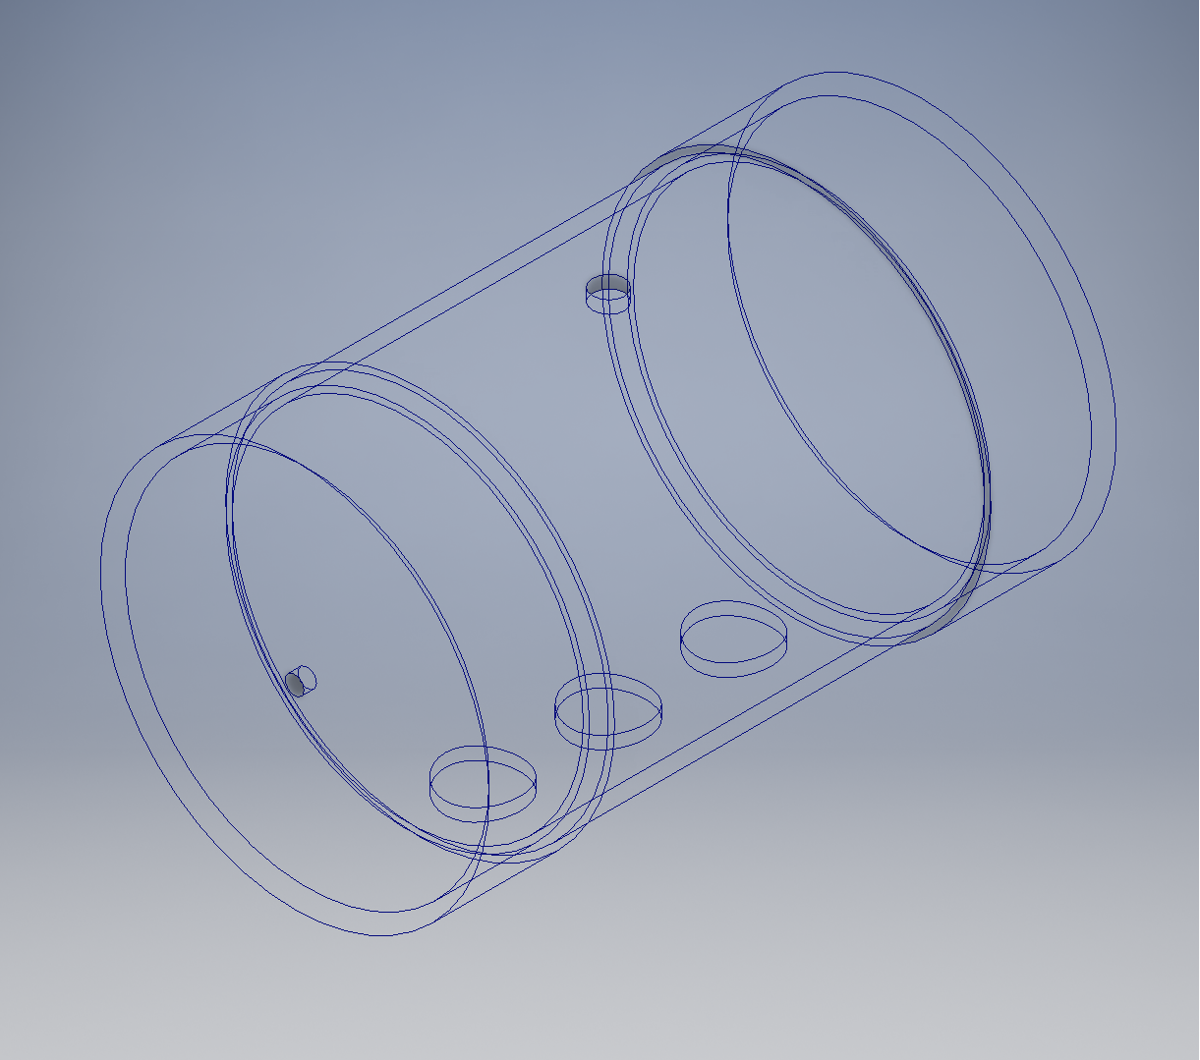
BALLAST SYSTEM
Our ballast system consists of two ballast tanks.
Two 16g CO2 cartridges.
This system saves:
Battery power
Time

Slide 28
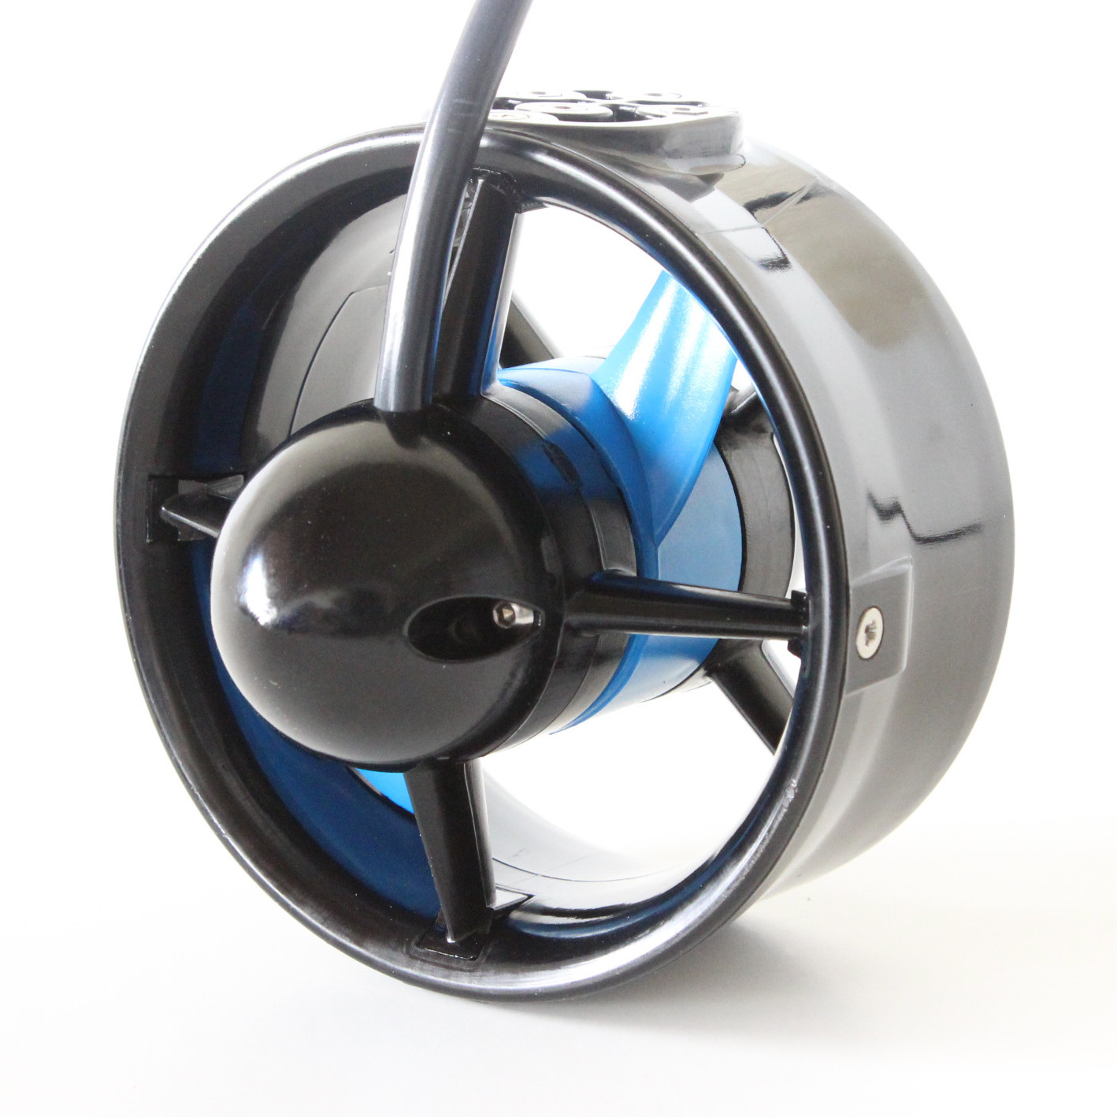
BUILD VS. BUY
ADVANTAGES & DISADVANTAGES
BUILD We only have to pay for materials and tools More customization options More time required to machine and design Requires more testing to everything is functioning properly | BUY Quality assurance guarantee Requires less time to incorporate with our design No advanced machining tools or machines required
Notes:
As opposed to completely constructing a quadcopter frame from scratch, we decided to buy and assemble a commercial quadcopter frame. A commercial frame can potentially provide us greater precision, but most importantly, it can save time and money. In order to machine a carbon fiber frame ourselves, our mills would require specialized tools, potentially costing hundreds of dollars and lots of time to learn how to set up properly and prepare.
For movement underwater, we use four T-200 Blue Robotics Brushless Motors, with motor mounts included. As opposed to buying M-200 Motors which do not contain shrouds and motor shrouds, the T-200s provide more security.

Slide 29
MANUFACTURING PROCEDURES
Notes:
Good Evening, my name is Jesse Leal and I am the Director of Manufacturing. (josh introduces himself) Tonight, we will be providing an insight in Echo Technologies’ Manufacturing procedures.

Slide 30
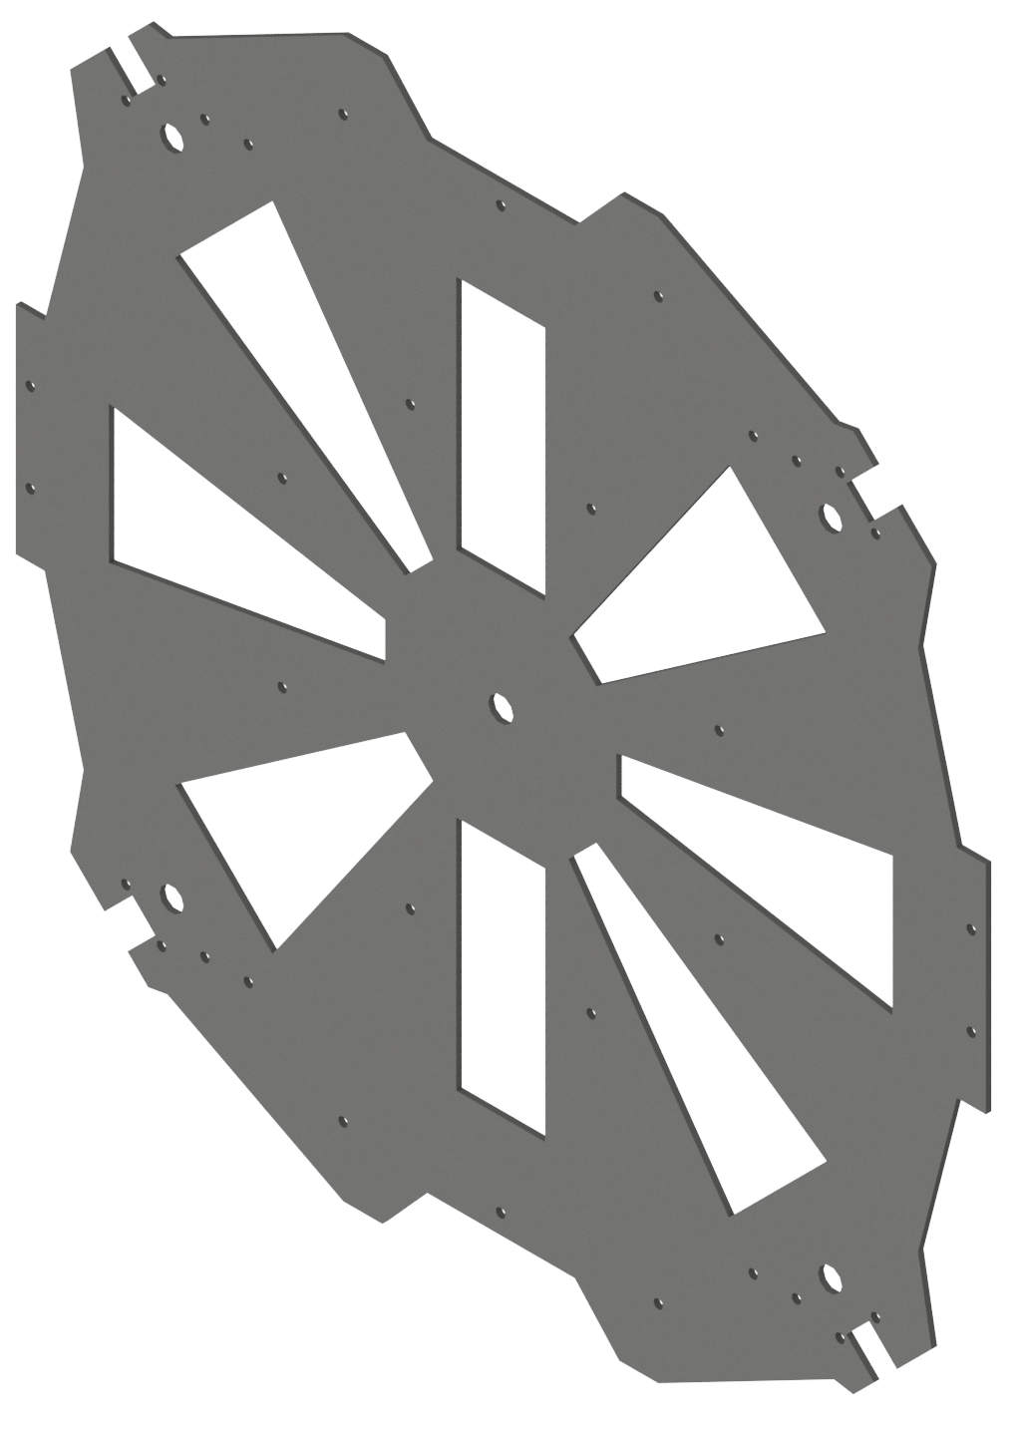
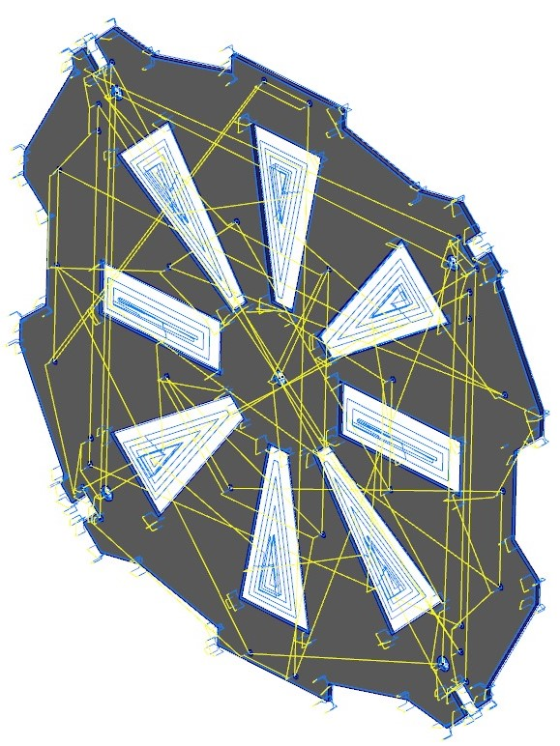
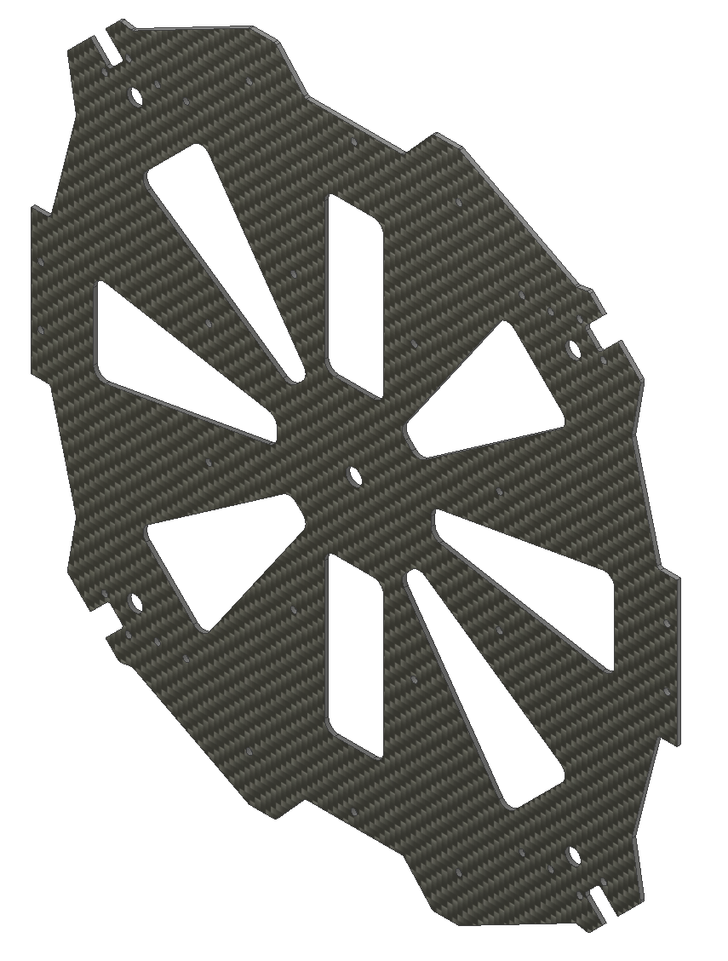
FABRICATION PROCESSES
CAD
CAM
PRODUCT
Final Product*
Notes:
Both Joshua and I are nationally certified machinists with a broad manufacturing experience. We begin our process by analyzing the 3D-modeled component’s material and features. Next, we program the 3D model into a CNC (Computer Numerical Control) program, execute the program and manufacture precise components. The process depicted behind me is a simplified example of manufacturing Megladon’s top frame.

Slide 31
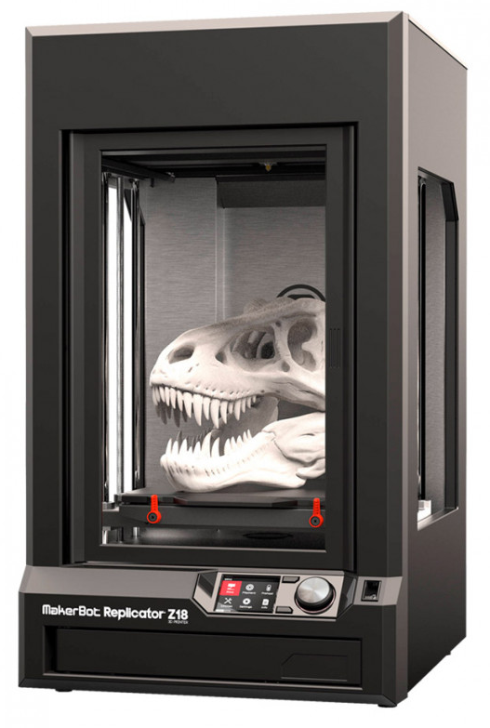
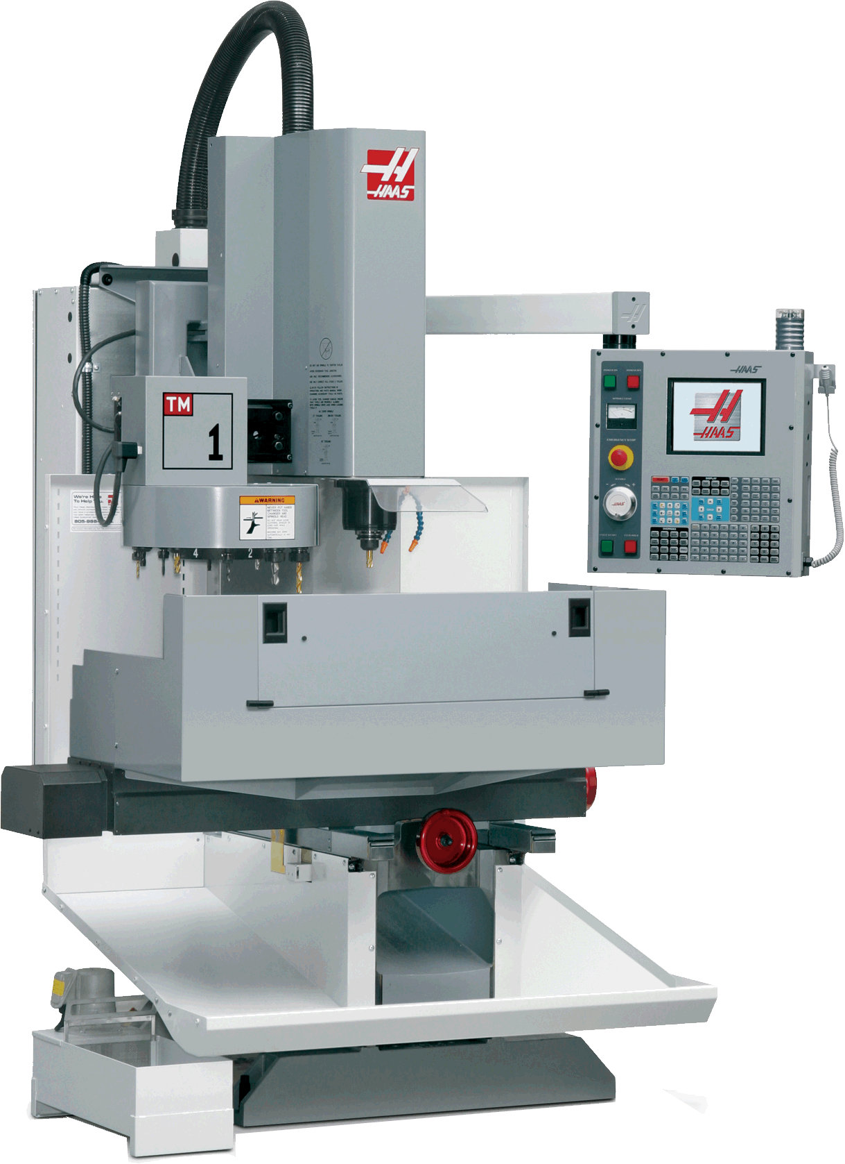
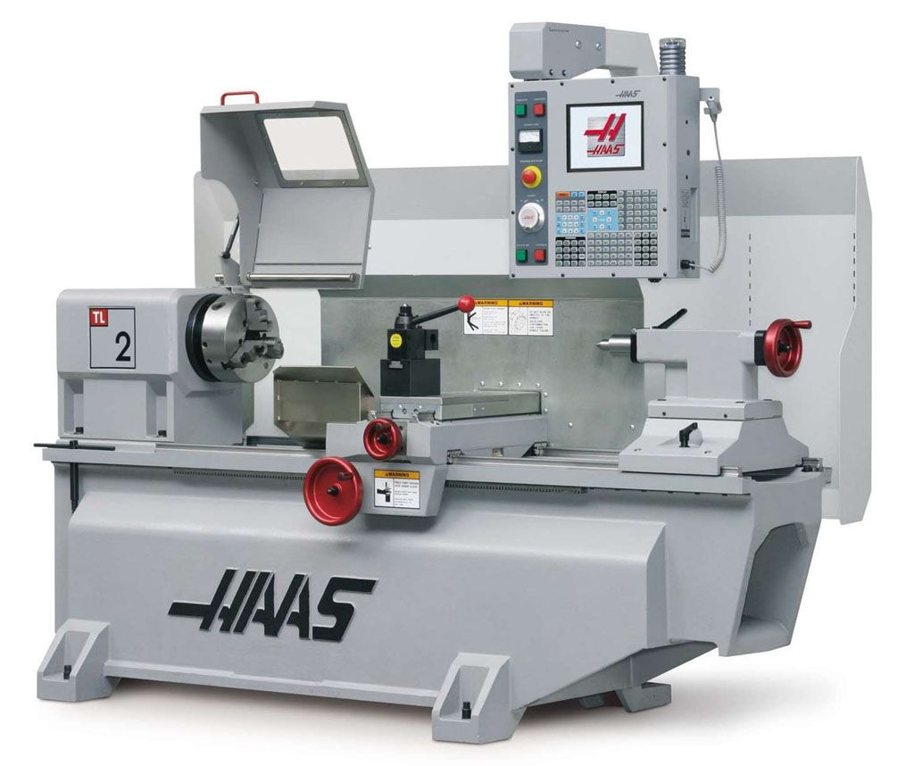
TYPES OF FABRICATION
Subtractive Manufacturing
Milling
Turning
Laser Cutting
Additive Manufacturing
Welding
3D Printing
Notes:
Josh- Talk about the machines we can operate and the ones we have available to us. And if not how we will outsource to other companies.
we can use subtractive manufacturing for the parts that will be under more stress and for more complex parts that would require a closer eye. this can easily be done at the local machine shop on the cnc mills and lathes available. Additive manufacturing will be focused on the smaller parts that will be placed in the interior of the robot. This is a less intrusive process that can easily be done in the annex on the readily available 3d printers.
If needed, welding or other complex procedures will be sent to other machine shops that others on our team
Mill- https://www.google.com/url?sa=i&source=images&cd=&ved=2ahUKEwjJxtTlstDeAhXQ5J8KHbpdBhIQjRx6BAgBEAU&url=http%3A%2F%2Fsteecon.info%2Fcapabilities%2F&psig=AOvVaw0k0MsT4at-QLuXBEBC_A6_&ust=1542165085284364
Lathe- https://i.pinimg.com/originals/5f/86/82/5f8682b15ece126f8f62e0a48e9fef92.jpg
Makerbot- https://www.google.com/url?sa=i&source=images&cd=&ved=2ahUKEwjynLOEtdDeAhWS0J8KHd9nBZUQjRx6BAgBEAU&url=https%3A%2F%2Fwww.makerbotstore.com.br%2Fimpressora-3d-makerbot-replicator-z18&psig=AOvVaw0YYoI4FL3tuPE0gqKqq7FN&ust=1542165665733110

Slide 32
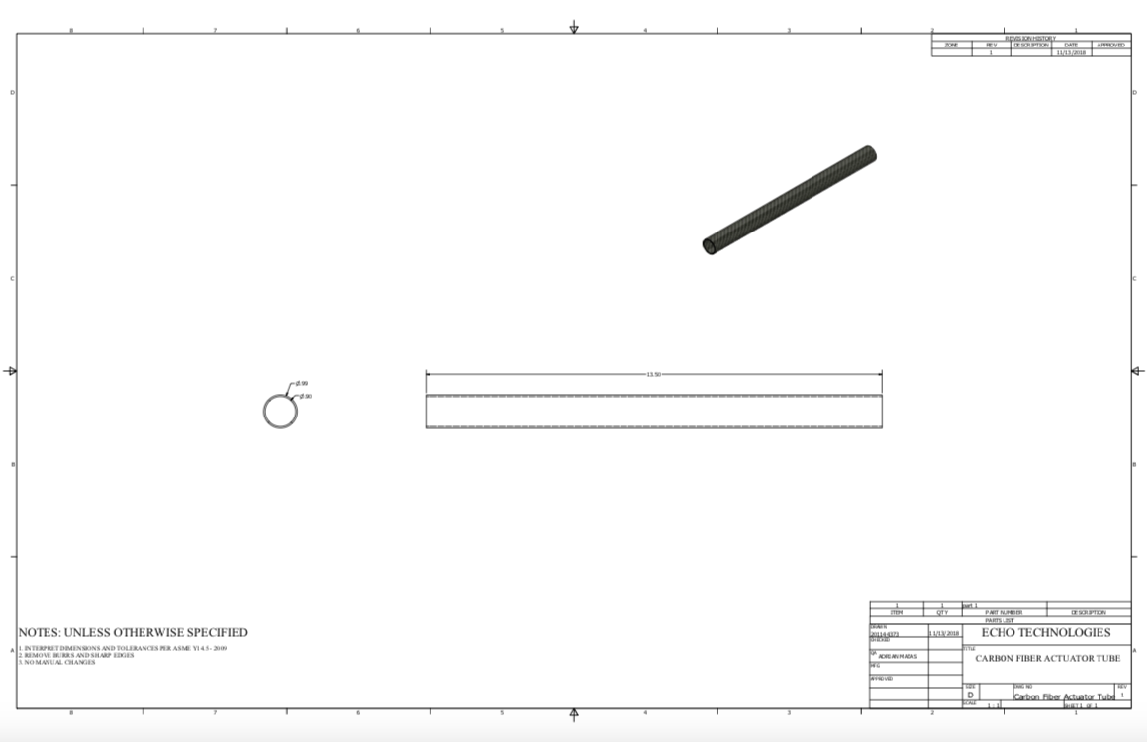
TECHNICAL DRAWINGS
PARTS FOR THE AERIAL SUBSYSTEM
Notes:
“Here we have technical drawings created on autodesk inventor illustrating parts of the quadcopter. Each part was CADed by the mechanical team and each drawing was approved by the quality assurance manager.”

Slide 33
ELECTRICAL COMPONENTS
Notes:
Taste of CAMS

Slide 34
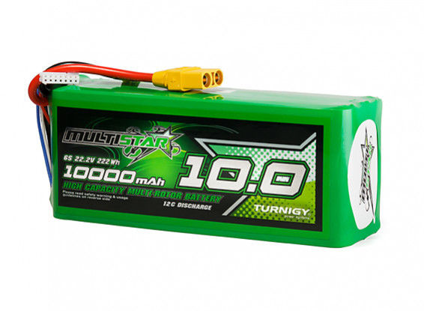
BATTERY
Multistar High Capacity Lithium-Polymer (LiPo) Battery
10000mAh 6S 22.2V
Can provide up to 120 amps continuously
Will provide power directly to the underwater and aerial motors

Slide 35
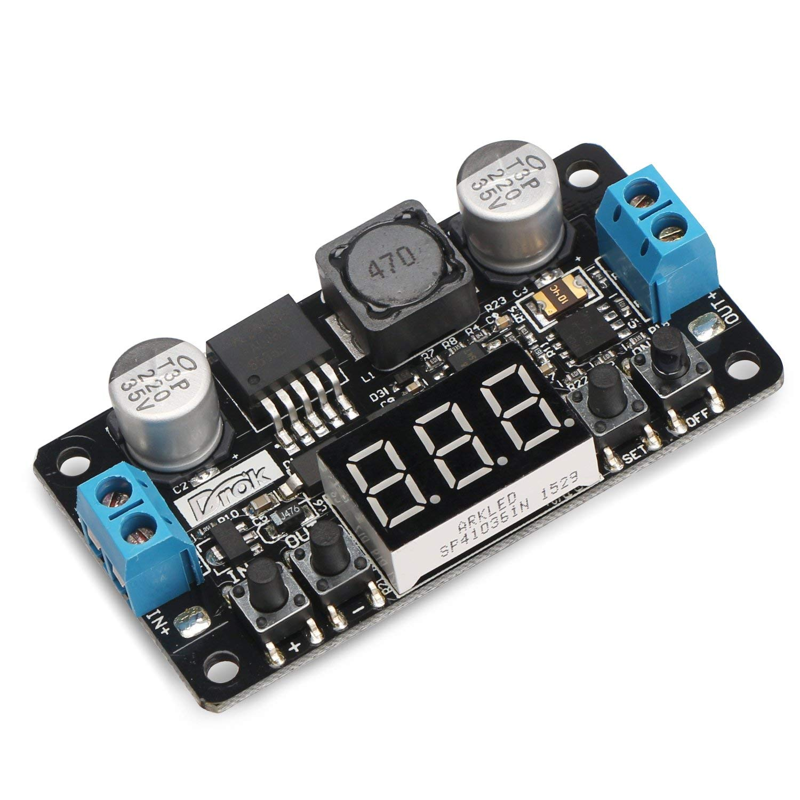
VOLTAGE REGULATION MODULE (VRM)
DC Voltage Step Down Circuit (Buck Converter)
Lowers 22.2V battery output voltage to 5V operating voltage
Used when providing power to low-voltage components (Raspberry Pi, IMU, Flight Controller, Servo)

Slide 36
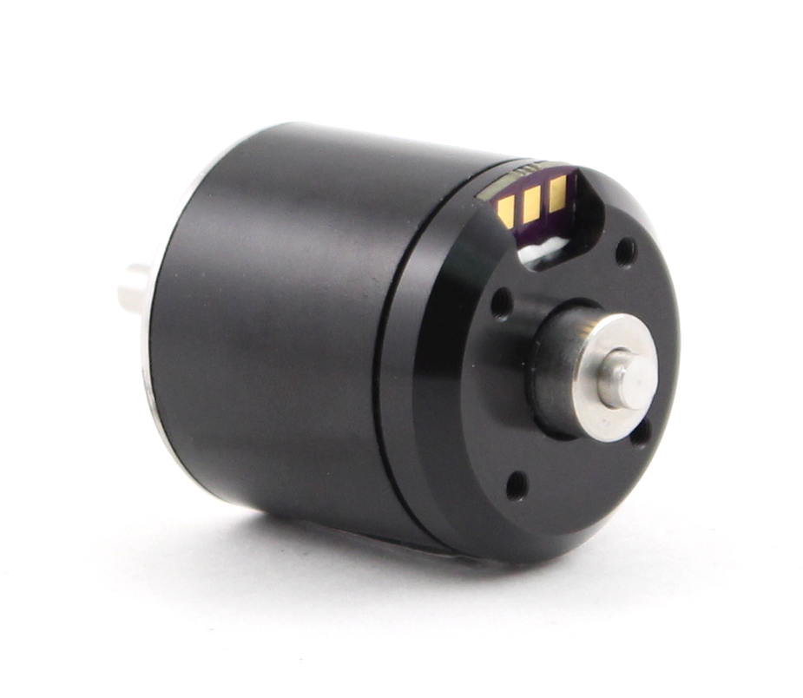
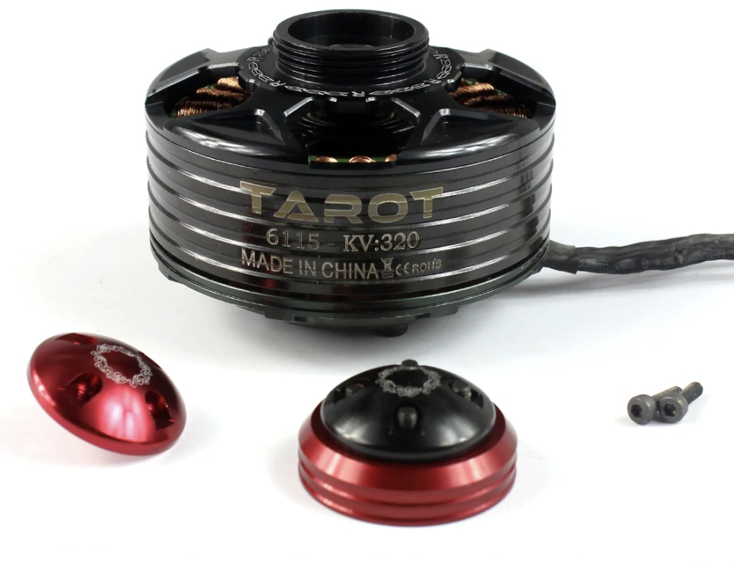
MOTORS
UNDERWATER MOTORS
Blue Robotics M200 Brushless Motor
AERIAL MOTORS
Tarot 6115 kv320 Brushless Drone Motor
Purpose built waterproof ROV motor
Up to .5 Nm (4.5 in-lb) of torque per motor
6-20 V operating voltage / 22 amp max current
Recommended motor for drone frame
Up to 11 lbs of thrust per motor when paired with 26 in propellers at 24 V
More than doubles the estimated thrust needed to lift the finished Megalodon

Slide 37
POWER
Notes:
Taste of CAMS

Slide 38
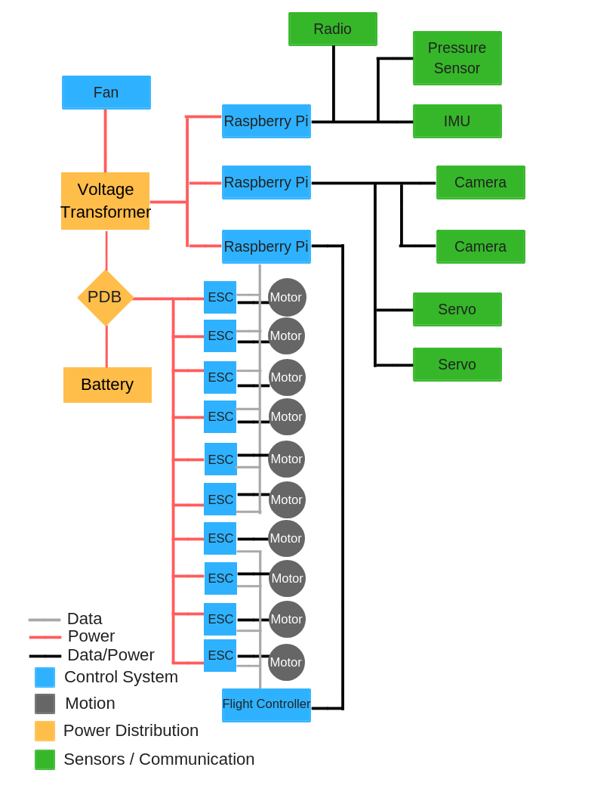
POWER DISTRIBUTION
One LiPo Battery
Brushless motors
Electronic speed controllers
Raspberry Pi 3 Model B boards
Sensors
Flight Controller
Servos + Cameras

Slide 39
CONTROL SYSTEM
Notes:
Taste of CAMS

Slide 40
CONTROL SYSTEM
3 Raspberry Pi Model 3 Programming Boards
Raspberry Pi #1
Flight controller with integrated Inertial Measuring Unit (IMU)
Four aerial motors attached to flight controller through electronic speed controller (ESC)
Raspberry Pi #2
Six underwater BlueRobotics M200 ROV Motors connected through ESC’s
Additional IMU to monitor robot orientation and locomotion
Two waterproof servos to actuate claw
Pressure Sensor
Raspberry Pi #3
Two high pixel density waterproof cameras and vision processing

Slide 41
SOFTWARE
Notes:
Introduction: Ted
Itohan
Sammy
Cynthia
Yajaira -> lead into talk about processing

Slide 42
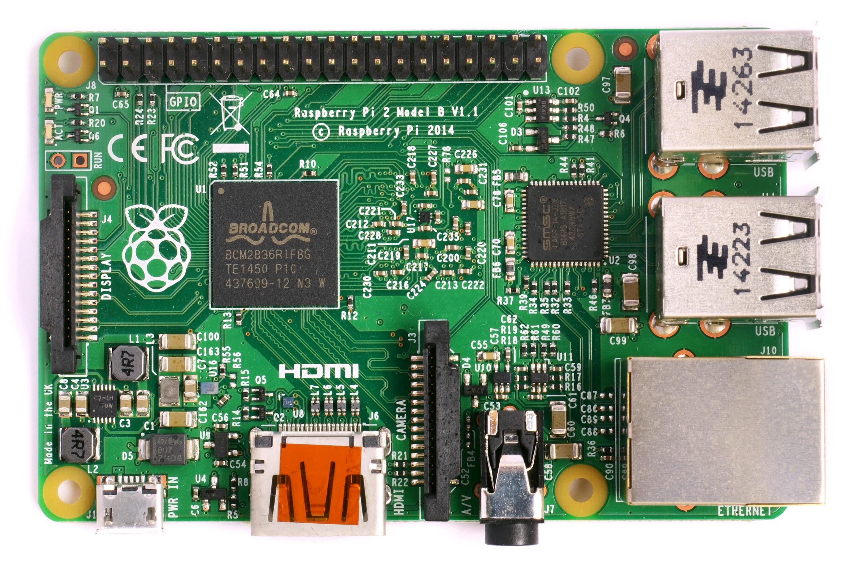
PROCESSING
SOFTWARE
Raspberry Pi 3 Model B
Processing speed: 1.2GHz with 32kB Level 1 and 512kB Level 2 cache memory
Compatibility / Adaptability
Notes:
yajaira
possible question: why raspberry pi over other processors like beaglebone black / arduino
answer: the raspberry pi is simpler to interface with than the beaglebone black and has wider documentation for different libraries. arduino doesn’t offer enough customizability / lack of vision processing capability
We will be using the raspberry pi 3 model b. We chose this processor due to its fast processing speed and adaptibility.

Slide 43
PROCESSING
SOFTWARE
Raspberry Pi 1
Interface with sensors
Raspberry Pi 2
Commands the Megalodon to move
Raspberry Pi 3
Image processing
Notes:
yajaira
We will be using three Raspberry Pis total. The first Raspberry Pi will work in hand with the planned sensors to be used. The second Raspberry Pi will operate in a control loop, commanding the Megalodon to move. The third Raspberry Pi will be used for image processing in order to increase efficiency, given that there is a lot of data from the camera.

Slide 44
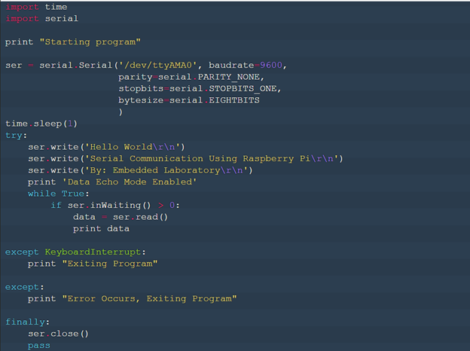
PROCESSING
SOFTWARE
Pi to Pi Communication
USB to TTL converter
Python Serial Connection
Pi Serial Packet
Nano Directory
Serial Monitoring Software
Notes:
yajaira
Possible Question: Why a serial communication?
Answer: We decided to use a serial communication as opposed to other pi to pi communication methods such as I2C and network cables / micro usb because I2C increases points of failure, since we would have to add a bread board, giving us another thing to worry about. The network cables and micro usb would require an ethernet port, but we cannot do that because we are using a “diet” Raspberry Pi and removing the ethernet ports.
We will be using a Pi serial communication to communicate among the Raspberry pis. The communication will be programmed on Python. We will basically use the USB to TTL converter to connect the raspberry pis to a laptop. We will then install PySerial packet onto the Raspberry Pi, and then enable serial communication by editing the config.txt, which will be opened using the Nano Directory. This is an example of the

Slide 45
FRAMEWORK
SOFTWARE
Program:
Processes high amount of input/output (I/O)
High-level code handling low-level components
What we want:
Concurrency (parallel processing)
Control over our subprocesses
Notes:
Since we have multiple sensors outputting data that our high-level code needs to process and respond by handling low-level components such as the motors, our program is going to be processing a high amount of input/output (I/O). Thus, it’s critical that the program does not remain idle while waiting for certain tasks to complete. What we need in order to accomplish this is concurrency; have a process split into components that can handle our subprocesses simultaneously.

Slide 46
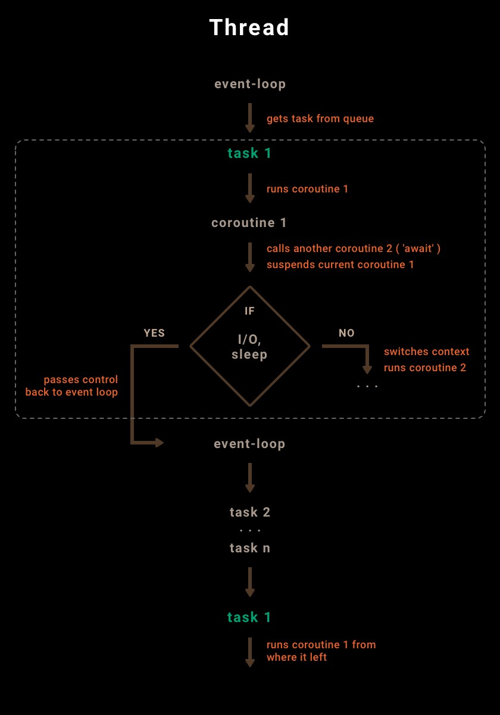
FRAMEWORK
SOFTWARE
Solution:
Use asynchronous I/O
Python module: asyncio
Utilizes async/await syntax
How does asyncio work?
Coroutines
Tasks
Event loop
Notes:
Our solution is instead of using synchronous I/O, where statements are executed sequentially and one by one, we’ll use implement this concurrency through single-threaded asynchronous I/O. The Python asyncIO module, which utilizes coroutines, tasks, and a main event loop to improve efficiency, offers this functionality. Unlike generators, which generate sequences of values for iteration, coroutines are generators that consume and pipe out data sent to it. The event loop, which works similarly to a central executor, iterates over tasks -- schedulers for coroutines -- in a queue and runs them. In the event that a particular coroutine calls another coroutine, the current coroutine will be suspended for a context switch; similarly, if a coroutine must execute blocking code, it will be suspended so that the event loop can run other tasks in the queue and return to it after the other tasks have finished executing. Ultimately, utilizing asyncIO allows the program to run non-blocking I/O, which will be a great benefit to the program that processes a high amount of I/O.
.
Solution:
Use asynchronous I/O
Execute statements non-sequentially
Coroutines
Similar to generators
Consumes data instead of generating; pipes out received data
Can call other coroutines (results in context switch)
Tasks
Schedulers for coroutines
Event loop
Central executor for all tasks
Moves on to other tasks in queue while task w/ idle coroutine is running

Slide 47
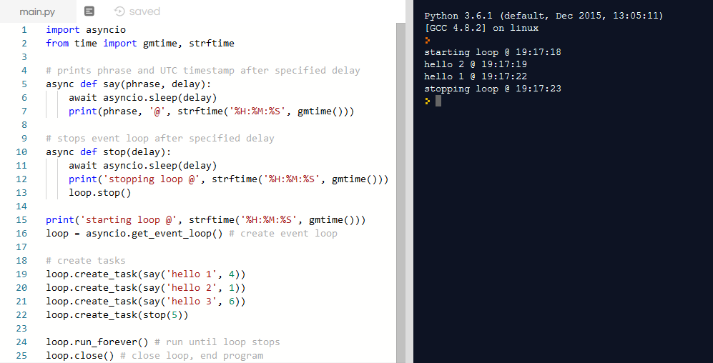
FRAMEWORK
SOFTWARE
Notes:
Here’s a code sample on the left and a diagram on the right to help comprehend how asyncio works. At lines 5 and 10, we define the say and stop coroutines that perform different operations after a specified delay. On line 15, we create the main event loop responsible for executing all the tasks, which we create on lines 18-23. The tasks are responsible for scheduling and running the parameter coroutines. The first task in the queue executes the coroutine that prints “hello 1” after 4 seconds. However, since the following coroutine has a shorter delay, the coroutine will pass control back to the event loop and execute the task that runs the coroutine that prints “hello 2”. Eventually, the event loop will go back to the first task and run coroutine 1 from where it left off. his is why hello 2 is printed before hello 1; the program’s asynchronous behavior allows us to run multiple subprocesses simultaneously. Similarly, since the stop() coroutine will finish execution before the say(‘hello 3’) coroutine with a delay of 6 seconds, hello 3 will never be printed because the event loop is stopped before it’s able to be printed.

Slide 48
FRAMEWORK
SOFTWARE
Goals:
Optimize response time
Minimize latency & interference
Component speeds:
Position controller/estimator (low)
20 Hz
Attitude controller/estimator (medium)
200 Hz
Motor controllers (high)
500 Hz
Notes:
cynthia

Slide 49
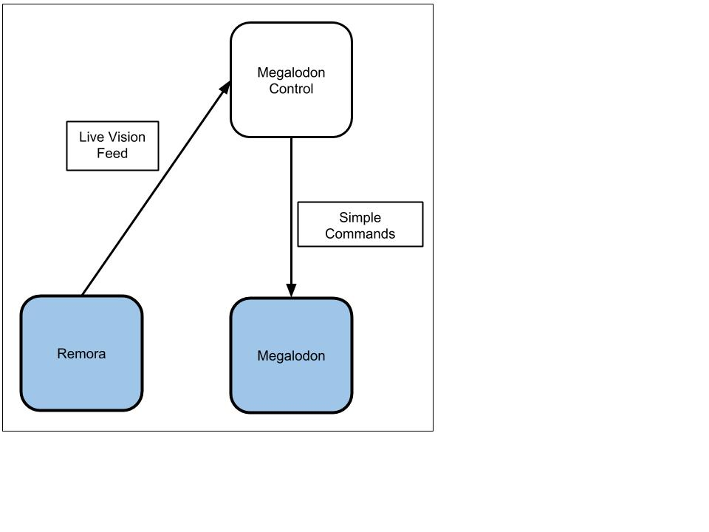
UNDERWATER CONTROL
SOFTWARE
General Strategy:
Remora sends visual input to human control.
Human control sends simple commands to move Megalodon to the vicinity of the object.
Automatic vision optimise Megalodon orientation and command itself to
adjust accordingly.
Notes:
sammy
The Remora will act as a third-person camera during the Megalodon’s time underwater. A communication system will be developed such that simple open-looped commands (forwards, backwards, turning) can be sent from mission control to the Megalodon during underwater operation. The pilots will control the Megalodon to reach the general vicinity of the objects of interest. Because of challenges with real-time communication, human-piloted control will be limited. An underwater vision system to autonomously orient the Megalodon to pick up the objects of interest will then activate.

Slide 50
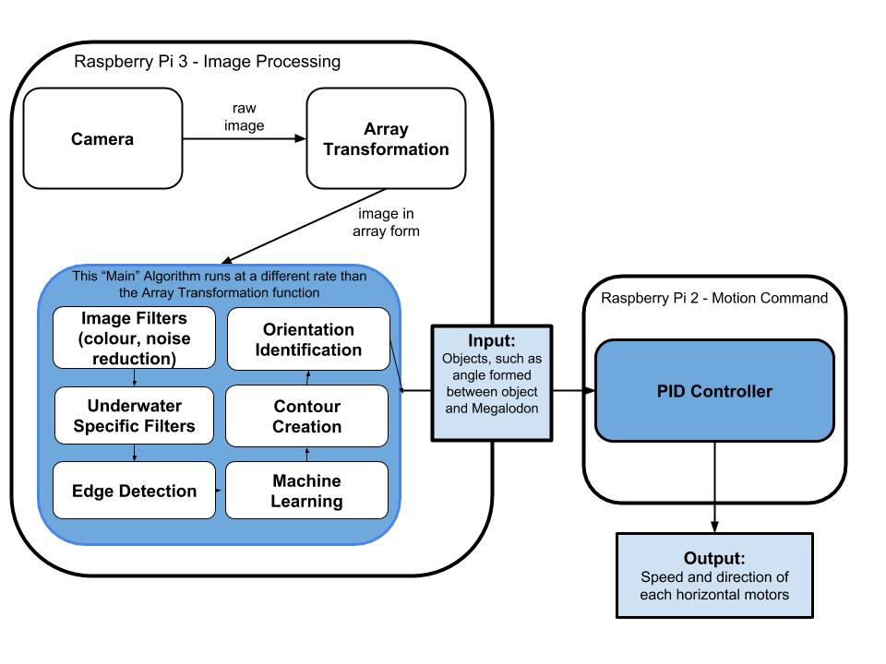
IMAGE PROCESSING
SOFTWARE
Notes:
sammy Camera will capture images, array transformation will be done, certain arrays will be periodically chosen so that it can pass through the greater bulk of image processing functions. Filters, Edge Detection, Optimisation of the computer vision that recognise the object via Machine Learning, Contour Creation, and finally Object Identification. When the object is
identified, we will have a sufficient input, including but not limited to the angle formed between object and Megalodon.

Slide 51
CAMERA SELECTION
SOFTWARE
USB 2.0 (compatible with Raspberry Pi 3 Model B)
3.9 x 1.6 x 1.2 (in.) and 0.8 oz
640 x 480 resolution
Adjustable focus, moderate framerate (~20 fps)
Notes:
sammy This is the camera

Slide 52
UNDERWATER MOTION
SOFTWARE
Notes:
sammy

Slide 53
UNDERWATER CONTROL
SOFTWARE
Attitude Control
A PID Controller will be used to maintain the speed and direction of the motors which will maintain the Megalodon’s underwater angle and motion.
Notes:
sammy

Slide 54
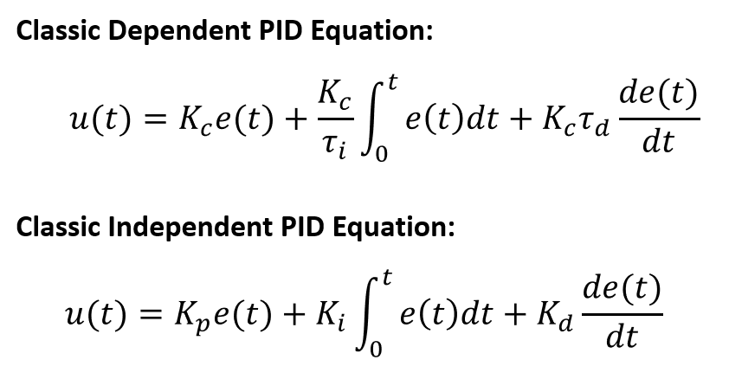
PID CONTROL
SOFTWARE
Output = Proportional + Integral + Derivative
Proportional → takes error
Integral → takes sum of error over time
Derivative → takes rate of (how fast / how slowly) change in error over time Proportional → this value is needed to gauge necessary input for reaching certain output
Integral → speeds up the process of reaching output relative to how much error is left
Derivative → predicts behavior of process relative to how much error is left
Notes:
sammy - “PID stands for Proportional Integral Derivative. u(t) is the desired output. This can be certain end variables we want for vision processing, flight control, and underwater control. Kp, Ki and Kd are PID gains, (a proportion of output over input)
- K is a constant, whereas Time Ti and Td are tuning parameters.

Slide 55
UNDERWATER CONTROL
SOFTWARE
How PID will be used for automatic vision tracking:
Input:
Objects, such as location relative to Megalodon, from image processing (this also serves as the error for the PID algorithm)
Output:
Speed/power sent to each underwater subsystem motor
Goal:
Megalodon turns / maneuvers underwater
Notes:
sammy - input is raw image,
centre of camera / frame and where object is (find the error between centre of camera and object position for angle error)
output is the speed of the rotor.
Underwater: PID Megalodon
make algo that turns motors for underwater motion. PID Solves for the right motion.

Slide 56
IMAGE PROCESSING
SOFTWARE
Notes:
sammy This is the combined diagram of the image processing and underwater motion control

Slide 57
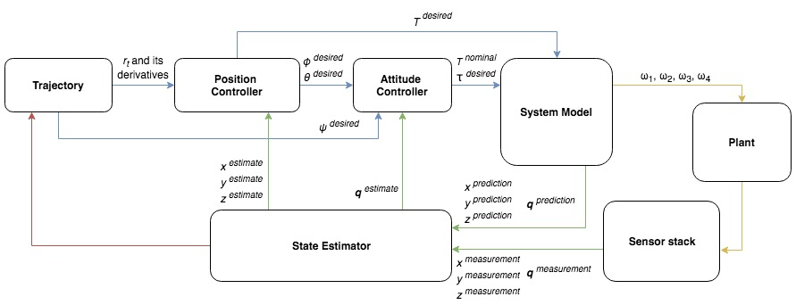
FLIGHT CONTROL
SOFTWARE
Notes:
ted
This is our control diagram for flight. It displays the inputs and outputs for each block in our control system.

Slide 58
FLIGHT CONTROL
SOFTWARE
Notes:
ted
The section on the left represents code that we run before the mission. Here we have our trajectory generator, which will calculate a minimal-snap path for the aerial subsystem of the Megalodon to follow. Snap is the fourth derivative of position, and we want to minimize it to smooth out our flight motion and ensure the feasibility of following it accurately. The trajectory will store points that contain the Megalodon’s theoretical 3D position, velocity and acceleration at intervals of 50 milliseconds throughout the motion.
The section on the right contains the hardware portion of the Megalodon. The plant represents the Megalodon vehicle as a whole. As you can see we have the four desired angular velocities for each rotor going into the plant. We also have our sensor stack feeding measurements back into the control loop.
The middle section contains the bulk of the software that will run real-time on the Megalodon. The following slides will illustrate the details of each block.

Slide 59
FLIGHT CONTROL
SOFTWARE
Notes:
ted
Up first, we have our position controller. We can see that the position controller actually manipulates angles. You can see pitch and roll here as outputs. This is because quadrotor dynamics work such that we achieve translational motion by tilting the vehicle.

Slide 60
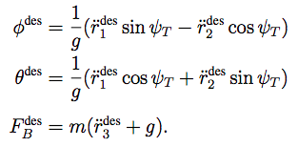
Position Controller
ψ ^{desired}
φ ^{desired}
θ ^{desired}
(desired yaw, roll, and pitch)
ψ_{t}
r_{t}
(trajectory point vector and its associated velocity and acceleration)
Trajectory
(20Hz)
Attitude Controller
x, y, z ^{estimated}
(estimated x, y, z position and associated derivatives)
T ^{des}
(desired thrust force)
State
Estimator
(200Hz)
System
Model
* There is a clash of notation here.
We denote F^{des} in this equation as T^{des} elsewhere in our control algorithm.
Notes:
ted
The position controller takes a trajectory point from the precalculated trajectory. Our target trajectory point will be the next closest trajectory point to our current estimated position. We will then pull the planned 3D velocity and acceleration vectors associated with that target trajectory point.
We will input values from the target trajectory point and our current state estimates into a PID on position, shown in the top equation. The PID will output a desired acceleration vector for the Megalodon’s center of mass. With the desired acceleration vector, we can then use this next set of three equations to calculate the necessary roll, pitch, and overall thrust force needed to move the Megalodon to the next target trajectory point. The yaw from the trajectory will remain unmodified. The orientation information will be passed to the attitude controller, and the desired thrust force will be passed directly to the system model.

Slide 61
FLIGHT CONTROL
SOFTWARE
Notes:
ted
Next up, our attitude controller will run at 200 Hz. This is responsible for making sure the Megalodon stays in a controlled orientation.

Slide 62
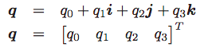
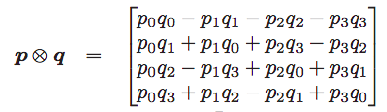
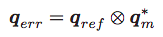
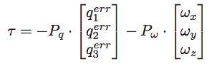
Attitude Controller
ψ ^{desired}
φ ^{desired}
θ ^{desired}
(desired yaw, roll, and pitch as Euler angles)
Position
Controller
(20Hz)
τ_{1, 2, 3}
(desired torque along the x, y, and z axes)
System
Model
q ^{estimated}
(estimated orientation as a quaternion)
T ^{nominal}
(nominal thrust needed to keep the Megalodon steady in the air)
State
Estimator
(200Hz)
Notes:
ted
Here, you can see that we take the desired orientation from the position controller as input. We also take a state estimate of our orientation, but we use a different representation called a quaternion.

Slide 63
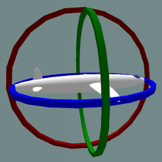

ORIENTATION REPRESENTATION
SOFTWARE
Euler Angles
Rotation around each of the major axes.
Represented by yaw, pitch, and roll.
Gimbal Lock
When the rings align, we lose track of one degree of freedom
Once we stop keeping track of that information, it’s impossible to reorient the axes again.
Notes:
ted
So why do we suddenly introduce this new orientation representation called a quaternion? Well, there’s a problem with the yaw, pitch, roll format, which is formally known as the Euler angle representation. This problem is gimbal lock. To understand gimbal lock, we can visualize Euler angles as these rings of possible rotation. In this illustration, the yaw is the blue ring, the pitch is the red ring, and the roll is the green ring. Gimbal lock occurs when rings of rotation align. In this example, the yaw and roll align. If the vehicle starts spinning in that shared ring, we lose track of one of those degrees of freedom. It becomes impossible to regain the lost degree of freedom and reorient ourselves. Quaternions solve this problem.

Slide 64
ORIENTATION REPRESENTATION
SOFTWARE
Euler Angles
Rotation around each of the major axes.
Represented by yaw, pitch, and roll.
Gimbal Lock
When the rings align, we lose track of one degree of freedom
Once we stop keeping track of that information, it’s impossible to reorient the axes again.
Notes:
ted
So why do we suddenly introduce this new orientation representation called a quaternion? Well, there’s a problem with the yaw, pitch, roll format, which is formally known as the Euler angle representation. This problem is gimbal lock. To understand gimbal lock, we can visualize Euler angles as these rings of possible rotation. In this illustration, the yaw is the blue ring, the pitch is the red ring, and the roll is the green ring. Gimbal lock occurs when rings of rotation align. In this example, the yaw and roll align. If the vehicle starts spinning in that shared ring, we lose track of one of those degrees of freedom. It becomes impossible to regain the lost degree of freedom and reorient ourselves. Quaternions solve this problem.

Slide 65
ORIENTATION REPRESENTATION
SOFTWARE
Euler Angles
Rotation around each of the major axes.
Represented by yaw, pitch, and roll.
Gimbal Lock
When the rings align, we lose track of one degree of freedom
Once we stop keeping track of that information, it’s impossible to reorient the axes again.
Notes:
ted
So why do we suddenly introduce this new orientation representation called a quaternion? Well, there’s a problem with the yaw, pitch, roll format, which is formally known as the Euler angle representation. This problem is gimbal lock. To understand gimbal lock, we can visualize Euler angles as these rings of possible rotation. In this illustration, the yaw is the blue ring, the pitch is the red ring, and the roll is the green ring. Gimbal lock occurs when rings of rotation align. In this example, the yaw and roll align. If the vehicle starts spinning in that shared ring, we lose track of one of those degrees of freedom. It becomes impossible to regain the lost degree of freedom and reorient ourselves. Quaternions solve this problem.

Slide 66
Attitude Controller
ψ ^{desired}
φ ^{desired}
θ ^{desired}
(desired yaw, roll, and pitch as Euler angles)
Position
Controller
(20Hz)
τ_{1, 2, 3}
(desired torque along the x, y, and z axes)
System
Model
q ^{estimated}
(estimated orientation as a quaternion)
T ^{nominal}
(nominal thrust needed to keep the Megalodon steady in the air)
State
Estimator
(200Hz)
Notes:
ted
Quaternions, denoted as q, are represented by 4 elements, as shown in the top two equations. Quaternion multiplication is done by taking the Kronecker product. We will transform the orientation input from the position controller into quaternion form, which will be denoted as qref. qm is the our current orientation as determined from the state estimator. To calculate the error to feed into a feedback loop, we will multiply qref by the conjugate transpose of qm. We are using a P controller to output desired torque along each axis. This will feed into the system model, along with a nominal thrust value to maintain the Megalodon’s height.

Slide 67
FLIGHT CONTROL
SOFTWARE
Notes:
ted
Here, we will explain how our system model calculates desired angular velocities for each rotor from the desired thrust and torque of the entire vehicle frame.

Slide 68




System Model
T
T_{Σ}
(desired net thrust force)
Position
Controller
(20Hz)
ω_{1, 2, 3, 4}
(commanded angular velocity for each rotor)
Plant (Megalodon)
(500Hz)
τ_{1, 2, 3}
(desired torque along the x, y, and z axes)
Attitude
Controller
(200Hz)
Notes:
ted
The basis of our model of the quadrotor are the top two equations here. There is a quadratic relationship between the thrust provided by a single rotor and the angular velocity we are spinning the rotor at. There is also a quadratic relationship between the torque provided by a single rotor and the speed we are spinning the rotor at. We will empirically determine the thrust constant cT and the torque constant cQ. The final equation relates the angular velocity of each rotor to the overall vehicle thrust force and torque. We can manipulate this equation to solve for angular velocities. So, using the inputs from the position controller and attitude controller, we can calculate a command angular velocity to send to each motor.

Slide 69
FLIGHT CONTROL
SOFTWARE
Notes:
itohan
Hi, everyone! My name is Itohan Ero and I am Deputy Director of Programming. So now, we will move into the hardware section of the control loop.

Slide 70


SENSOR STACK
SOFTWARE
Inertial Measurement Unit (IMU)
Adafruit 9-DOF Absolute Orientation IMU Fusion Breakout Model-BNO055
Absolute Orientation
Angular Velocity
Angular Acceleration
Magnetic Field Strength
Linear Acceleration
Gravity
Temperature
Notes:
itohan
We will be using an Inertial measurement unit called the Adafruit to give data about temperature and gravitational force. but we will focus on is the values given about absolute orientation, angular velocity, and linear and angular acceleration. The bottom picture shows the IMU and the top unit shows the ability of the sensor to give live data about the orientation of the robot.

Slide 71

SENSOR STACK
SOFTWARE
Pressure Sensor
Bar02 Ultra High Resolution 10m Depth/Pressure Sensor
Depth: 10m
Water Depth Resolution: 0.16mm
Air Pressure Resolution: 13cm
Notes:
itohan
the other sensor will be a pressure sensor called the Bar02. So this sensor can give signals up to 10 meter deep and has a high water dept resolution of 10m and an air pressure resolution of 13cm. the pressure sensor and imu has some amount of uncertainty and we want our values to be as accurate as possible

Slide 72
FLIGHT CONTROL
SOFTWARE
Notes:
itohan
the data from the sensors is given to the state estimator

Slide 73

STATE ESTIMATION
SOFTWARE
Kalman Filter - Linear Position, Angular Position & Velocity
Notes:
itohan
why are we choosing to use kalman filter for only linear position, agular position, and velocity??
why did we choose the kalman filter?
So I have researched different filters to use and decided on the Kalman Filter because it provides estimates quickly and it’s easier to implement into our program.We will be using the Kalman filter for linear and angular position and angular velocity. The goal of the Kalman filter is to create estimates based on the measured values through the iterative process the estimates get closer to the “actual” value.

Slide 74


STATE ESTIMATION
SOFTWARE
Kalman Filter - Linear Position, Angular Position & Velocity
(1)
Notes:
itohan
So first a measuremnt from the sensors is taken. And the kalman gain calculates the error in the measurement and the orginal error of the sensors used (this is the error from the previous sensors that I described) ---> click for the equation. So to calculate it top part is estimate, r is error of measurement. Kalman gain gives us the error in the estimate vs the error in the data.This is a value between 0 and 1. This helps us determine which measurement is of importance for future estimate calculatons.

Slide 75


STATE ESTIMATION
SOFTWARE
Kalman Filter - Linear Position, Angular Position & Velocity
(2)
Notes:
itohan
So the next step is to figure out the new estimate by muultipying the measurement from the data by the Kalman gain.

Slide 76


STATE ESTIMATION
SOFTWARE
Kalman Filter - Linear Position, Angular Position & Velocity
(3)
Notes:
itohan
Finally we need to figure out the new error in the new estimate. This is done by subtracting the kalman gain from 1 and multiplying by the previous estimate.

Slide 77

STATE ESTIMATION
SOFTWARE
Kalman Filter - Linear Position, Angular Position & Velocity
Notes:
itohan
this closes the iterative loop of the processs

Slide 78
FLIGHT CONTROL
SOFTWARE
Notes:
itohan
The state estimator closes the loop by feeding our current estimated states to the position controller and attitude controller.

Slide 79
FLIGHT CONTROL
SOFTWARE
Notes:
ted
There is also a red line drawn to our trajectory planner in case we want to try adaptable trajectory generation on the fly in the future. But, we haven’t quite figured out how that’s going to work so we’ll just end it here. So that’s the fundamental control loop for flight. We call this the trajectory following flight control mode.
We can modify a few blocks at the “ends” of the loop based on our needs. For example, we can substitute a vision algorithm in place of the precalculated trajectory to create a vision targeting flight control mode. Since the vision algorithm would output the same values (desired position and orientation) as the trajectory points, we can directly substitute the blocks to completely change our control mode while keeping the fundamental loop the same.

Slide 80

HOVER CONTROL
SOFTWARE
Notes:
ted
One of the other main control modes we know we’ll be using is hover control mode. Here, we completely take out the position control component and input zero pitch and roll into the attitude controller. This control mode will be used to remain stationary in the air while waiting for other parts of the mission to be completed, to turn in a place to a desired yaw angle, or to regain stability after an aggressive flight sequence.

Slide 81
REMORA
Notes:
Kaitlyn

Slide 82

MECHANICAL DESIGN
REMORA
Central Receptacle
ABS Plastic Sheets
Motors
Hooks
Notes:
Kaitlyn

Slide 83

ELECTRICAL SYSTEM
REMORA
External Control Box to Tether
Power & Data
PDB to components
VRM
Raspberry Pi
Sensors/ Modules
USB Power
Arduino Uno
ESC/Motors
Notes:
Shohan

Slide 84
BALLAST SYSTEM
REMORA
Pneumatic Ballast Tanks/System
 | Efficiency | Functionality | Cost | Complexity | Size/Weight | Time | Total
Ballast Tanks | 5 | 5 | 3 | 3 | 3 | 3 | 22
Weights | 3 | 3 | 4 | 4 | 3 | 4 | 21
Buoyancy Foam | 2 | 3 | 4 | 5 | 2 | 4 | 20
Pool Noodles | 1 | 2 | 5 | 5 | 2 | 4 | 19
Notes:
Sean

Slide 85
RECOVERY SYSTEM
REMORA
Four Claw Missile Intake System
Allows for top and bottom side of missile to be easily obtained
Missile does not twist out of the claws’ grips
 | Cost | Weight | Efficiency | Time | Waterproof | Total
T Collector | 1.25 | 3.75 | 2 | 0.25 | 2.5 | 9.75
Vacuum | 0.25 | 1.5 | 1 | 0.25 | 1.5 | 4.5
Claw 2 | 1 | 3 | 3 | 1.25 | 1.5 | 9.75
Claw 4 | 0.75 | 2.25 | 5 | 1 | 1.5 | 10.5
Rollers | 0.75 | 2.25 | 4 | 1 | 1.5 | 9.5
Notes:
Giannka

Slide 86

VISION CAPABILITY
REMORA
Two IP69K mini cameras
Verification of the wreckage location
Prevents collision and loss of cargo
Prospective locations to position the beacon
Notes:
Silas

Slide 87

LOCATION SENSING
REMORA
SparkFun 9DoF Razor IMU M0
9 degrees of freedom
Sense position relative to reference point
Interface with Megalodon for Pickup
Notes:
Silas/Tommy

Slide 88

RADIOACTIVE DETECTION
REMORA
Reflective with Uranium glass
Visible in daylight
Lightweight
Meets recommended lumen requirement
Notes:
Kira

Slide 89

BEACON
REMORA
Ultrabright LED Flasher
Detectable using camera
Submersible
100 hr battery life
Visible from ½ mile
Weight: 0.5 oz
Notes:
AshleyVisible from a half mile away
100hr batt life

Slide 90
SYSTEM CONCEPTS
Notes:
Taste of CAMS

Slide 91
TESTING PROCEDURES
Environments: Altitude of 201.9 feet and ≥11 feet underwater (pool water)
Most components can survive in air, but not water.
All components potentially contacting with water will go under the Waterproof Procedure (will be adjusted to be appropriate for each component).
Enclosure Test Procedure
Open the enclosure.
Rip a strip of three squares of paper. Place it inside the enclosure.
Close the enclosure.
Place the enclosure on top of the weight and using the braided rope tie the two together by making parcel knots. Make sure the loose end(s) are coming from the top of the knotted object.
With one person holding the end of the rope, place the knotted enclosure and weight down into the pool at 7 ft.
Wait for 10 minutes before pulling it out of the water.
Open the enclosure and report the paper’s current condition.
Repeat steps 1 to 8 for each number of enclosures being tested.
Materials: 1 Braided Plastic Rope, 1 Roll of Thin Paper, 1 Heavy Weight, and # of Enclosures

Slide 92












ENCLOSURE TEST
1150 Protector Pelican Case
ML-58F*1508 ML Series Outdoor NEMA Enclosures Case

Slide 93


Mechanical: Motor Testing Rig
TESTING PROCEDURES
Programming: Drone Testing Bench
Notes:
Talk about the motor rig first (stand in front of the gif). Then talk about the drone bench.

Slide 94



COMMUNICATION
3 Communication Systems: In-air AV, In-air RC, and Underwater
AV
RC
Underwater
For FPV (first-person view)
5.8 GHz, radio waves
Camera -> transmitter -> receiver -> monitor at base
PWM (pulse-width modulation) signals
For drone control
2.4 GHz, radio waves
Remote input -> transmitter -> receiver on drone -> Raspberry PI #1 (signal processing)
PWM
For aquatic ROV control
5 kHz, sound waves
Button input -> transmitter (speaker) at base -> receiver on ROV (piezo condenser microphone) -> Raspberry PI #1
Each frequency maps to specific commands
Notes:
Underwater acoustic communication (sound)
Piezoelectric transducer
In-air Communication
Radio-controlled, 2.4GHz
Camera feed is 5.8GHz

Slide 95


QUALITY ASSURANCE
Consistent
Accurate
Precise
QUALITY ASSURANCE
Notes:
All parts manufactured are remeasured (dial caliper or other precision instruments)
A pull test is conducted on crimped wires using a gage and pliers. (60 lbs)
All technical data packages produced must be approved for proper dimensioning, GD&T standards, and tolerances.

Slide 96


Risk and Assumptions
RISK AND ASSUMPTIONS
Main Causes of Risk
Environment
Manufacturing
Testing
Accessing the Largest Risks
Actions Taken to Prevent Risk
Safety Protocols and Procedures
Flight
Diving
Manufacturing
Removal and Reduction of Hazardous Objects
Risks Relation to the Timeline

Slide 97
FINANCIAL REPORT

Slide 98
BUSINESS PLAN
Fundraising
Hold multiple successful fundraisers
Raise sufficient funds necessary to maintain status and purchase essential products
Sponsorships
Reach out to companies and industries for sponsorships and or donations
Motivo, Blue Robotics, Home Depot
Exploring Commercial Applications
Develop systems and strategies with a large range of applications
Communications, Search, Rescue, Recovery

Slide 99
BUSINESS PLAN
Purchasing Strategies
Maintain a formal budget
Comply with all rules and regulations as presented by CAMS ASB
Maintain close relationship with CAMS administration
Require all products to be approved by Management, Mr. Carpenter, Financial Team, Quality Assurance Officer, and Risk Management Officer
Maintaining Public Relations
Emphasize the importance of sustained public relations through ethical behavior and integrity in the industry
F.O.M. Interns
Act as an extension of the Financial Team with similar responsibilities
Notes:
open PO

Slide 100
APPROXIMATE BUDGET
SYSTEMS
Item No. | Vendor | Description | Part No. | Unit | QTY | Unit Price | Total Price
1 | Blue Robotics | M200 Brushless Motors | M200 | each | 4 | $95.00 | $380.00
2 | Amazon | Raspberry Pi Model B | RASPBERRYPI3-MODB-1GB | each | 3 | $37.30 | $111.90
3 | Amazon | eBoot Buck Converter | EXPSFD005794 | each | 1 | $11.99 | $11.99
4 | Fox Tech | Tarot X4 Quadcopter Frame | 1946 | each | 1 | $234.99 | $234.99
5 | Amazon | CyclingDeal 20X Bike Bicycle Air Pump Inflator 16G Co2 Threaded Cartridges | CD-CO2-20 | 20 | 1 | $24.00 | $24.00
6 | Amazon | Black CO2 Inflator for Bikes Tire By BriskMore | BT-003A | each | 1 | $14.90 | $14.90

Slide 101
APPROXIMATE BUDGET
SYSTEMS CONT.
Item No. | Vendor | Description | Part No. | Unit | QTY | Unit Price | Total Price
7 | Amazon | Revmega Tubeless Presta Valve Stem | VS02 | each | 1 | $12.99 | $12.99
8 | Amazon | Nylon Vacuum Flexible Tubing | B0092L1MLE | each | 1 | $30.58 | $30.58
9 | Amazon | Pump Air Wedge Alignment | FAW-02 | 3 | 1 | $16.99 | $16.99
10 | Amazon | Logitech USB Camera | B000VTQ3LU | each | 1 | $7.89 | $7.89
11 | Amazon | Adafruit 9-DOF Absolute Orientation IMU | ADA2472 | each | 1 | $34.95 | $34.95
12 | Blue Robotics | Bar02 Ultra High Resolution 10m Depth/Pressure Sensor | BAR02-SENSOR-R1-RP | each | 1 | $88.00 | $88.00

Slide 102
APPROXIMATE BUDGET
SYSTEMS CONT.
Item No. | Vendor | Description | Part No. | Unit | QTY | Unit Price | Total Price
13 | Amazon | 50.0 Mega Pixel USB HD Video Camera Webcam | NCOREJNJIJKKM362 | each | 1 | $4.69 | $4.69
14 | Amazon | Pelican 1150 Camera Case With Foam | 1150-000-110 | each | 1 | $40.00 | $40.00
15 | Polycase | ML Series Outdoor NEMA Enclosures | ML-58F*1508 | each | 1 | $42.00 | $42.00
16 | Blue Robotics | Cast Acryllic Tube (6" Series) | WTE6-ASM-R1-VP | each | 1 | $90.00 | $90.00
17 | Blue Robotics | O-Ring Flange | WTE6-ASM-R1-VP | each | 2 | $59.00 | $118.00
18 | Blue Robotics | Aluminum End Cap with 15 Holes (6" Series) | WTE6-ASM-R1-VP | each | 2 | $44.00 | $88.00

Slide 103
APPROXIMATE BUDGET
SYSTEMS CONT.
Item No. | Vendor | Description | Part No. | Unit | QTY | Unit Price | Total Price
19 | Blue Robotics | Enclosure Vent and Plug | WTE6-ASM-R1-VP | each | 1 | $8.00 | $8.00
20 | Blue Robotics | T200 Thruster | T200-THRUSTER-R1-RP | each | 4 | $169.00 | $676.00
21 | Adafruit | USB Type-A Jack | 2225 | each | 15 | $0.69 | $10.35
22 | Amazon | Assorted M3 M2.5 Nylon Screws Nut Standoffs | B06Y591NKK | 210 | 2 | $9.99 | $19.98
23 | Amazon | Mudder Black Aluminum Heatsink Cooler Cooling Kit | LYSB01LXWK626-ELECTRNCS | 10 | 2 | $5.99 | $11.98
24 | Amazon | Sandisk Ultra 32GB Micro SDHC UHS-I Card with Adapter | 1 A1 - SDSQUAR-032G-GN6MA | each | 3 | $9.59 | $28.77
Total Cost | $2,106.95

Slide 104
APPROXIMATE BUDGET
MISCELLANEOUS
Item No. | Vendor | Description | Part No. | Unit | QTY | Unit Price | Total Price
1 | Amazon | BookFactory Black Engineering Notebook | LIRPE-168-SGR-A-LKT4 | each | 1 | $29.99 | $29.99
2 | Name Cheap | Website Domain (echotechnologies.org) | N/A | each | 1 | $11.69 | $11.69
3 | Tie Mart | Blue Staff Tie | AC58NW-0014 | each | 50 | $2.50 | $125.00
4 | Signarama | Team Canvas Banner | N/A | each | 1 | $154.80 | $154.80
5 | FedEx | SPS Document | N/A | each | 1 | $197.36 | $197.36
Total Cost | $518.84

Slide 105
APPROXIMATE BUDGET
INTERNS
Item No. | Vendor | Description | Part No. | Unit | QTY | Unit Price | Total Price
1 | Amazon | ABS Plastic Sheet | B004UBWEVI | each | 3 | $9.98 | $29.94
2 | Blue Robotics | T100 Thruster | T100-THRUSTER-R1-RP | each | 6 | $119.00 | $714.00
3 | Alibaba | Waterproof IR Truck security Side View Camera | 720P AHD IP69K | each | 2 | $28.50 | $57.00
4 | Blue Robotics | Fathom ROV Tether R2 | FATHOM-TETHER-NB-4P-26AWG-100-R2 | each | 1 | $500.00 | $500.00
5 | Blue Robotics | Waterproof Servo | HITEC-D646WP | each | 8 | $56.00 | $448.00
6 | Arduino | ARDUINO UNO REV3 | A000066 | each | 1 | $22.00 | $22.00
Notes:
Kyle
Most of the parts for the Remora will either be purchased from Blue Robotics or Amazon. The parts that we do not buy will be made from ABS plastic which we will be ordering from Amazon.

Slide 106
APPROXIMATE BUDGET
INTERNS CONT.
Item No. | Vendor | Description | Part No. | Unit | QTY | Unit Price | Total Price
7 | Blue Robotics | Basic ESC | BESC30-R3 | each | 1 | $25.00 | $25.00
8 | Amazon | Raspberry Pi 3 Model B Motherboard | RASPBERRYPI3-MODB-1GB | each | 1 | $34.99 | $34.99
9 | Blue Robotics | Subsea Buoyancy Foam: R-3312 | FLOAT-R3312-R1-VP | each | 1 | $21.00 | $21.00
10 | Amazon | Loctite Epoxy Quick Set | 1395391 | each | 1 | $6.65 | $6.65
11 | Amazon | MG Chemicals Silicone Modified Conformal Coating | 422B-55ML | each | 1 | $12.95 | $12.95
Total Cost | $1,871.53
Notes:
Kyle
In total, the Remora will cost about $1800. This however does not include the control box that we will be using to control the rov.

Slide 107

SYSTEMS | $2,106.95 | 35.1%
MISCELLANEOUS | $518.84 | 8.7%
INTERNS | $1,871.53 | 31.2%
ADDITIONAL COSTS | $1,500 | 25.0%
PROJECTED
BUDGET
TOTAL | $6,000
Notes:
FIX THIS SLIDE!!!
add projected additional costs

Slide 108
OUTREACH

Slide 109

PURPOSE
OUTREACH
Educate the youth about Science, Technology, Engineering, Art & Math (STEAM) career pathways through interactive presentations and collaborative activities.
Diversity within in each STEAM field.
Give back to the community by helping students develop skills that will aid them in their future endeavours

Slide 110


GOALS & PLANS
OUTREACH
As the Outreach team, our main goal is to educate the youth about the possibilities that the STEAM fields possesses and to inspire the community to pursue a career in those fields.
How?
Hosting multiple STEAM events and workshops
Interactive lessons
Finding Nemo Themed Activities
Where?
Local middle schools and elementary schools
Community Day

Slide 111
MEDIA AND PUBLICATIONS

Slide 112

Documentary
Company Profile
Sponsorships
Social Media
Official Guides/Manuals
Legacy
PURPOSE
MEDIA AND PUBLICATIONS

Slide 113
QUESTIONS, COMMENTS, CONCERNS?

Slide 114

THANK
YOU!

